Slide 1
GWAS of SSNS
Data management, QC and exploratory analyses
03/03/2020

Slide 2
GWAS SSNS
Cases
Starting n = 762 multi-ethnic SSNS samples
Ancestry/ethnicity – Asian 386 (50.6%), Black 161 (21.1%) , Caucasian 149 (19.6%), Hispanic/”Mixed” (8.7%)
Genotyped on Illumina MEGA Global SNP chip
Controls
Initial controls: 1000 Genomes Phase 3 version 5

Slide 3
SSNS samples

Slide 4
Data management 1
QC’ed markers from SSNS samples used to extract matching markers by chromosome and position
Both datasets aligned and alleles checked against hg37 fasta
Markers passing QC reannotated against dbSNP151
Initial check with bcftools +fixref plugin

Slide 5
SSNS dataset checked against hg37
Pre
Post

Slide 6
1000G dataset checked against hg37

Slide 7
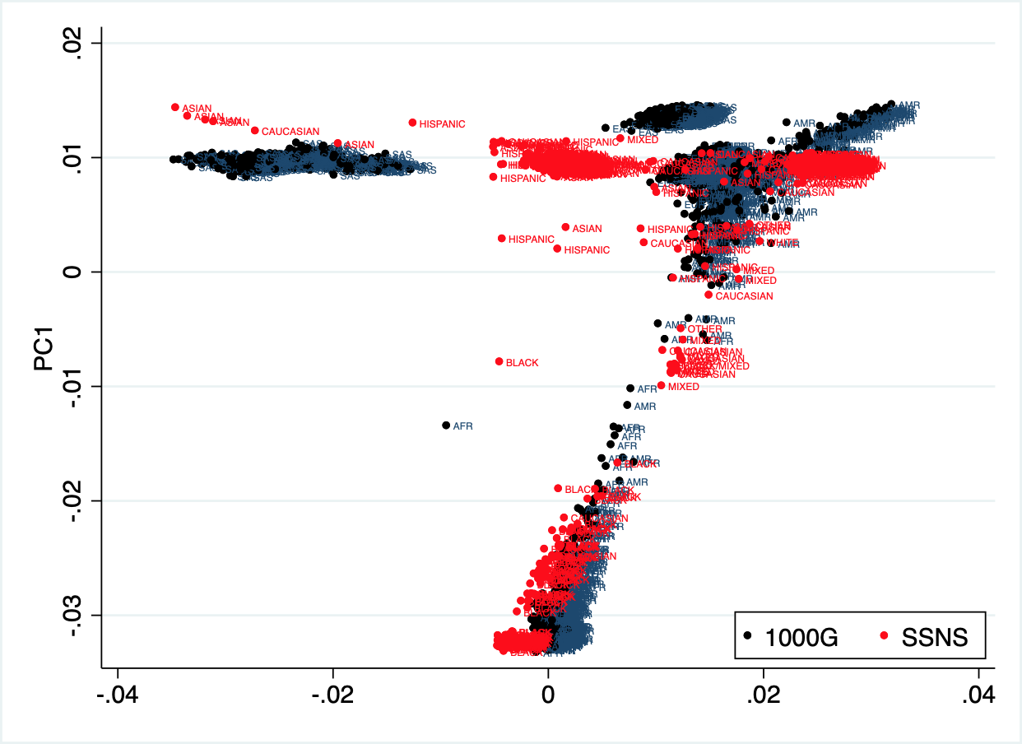
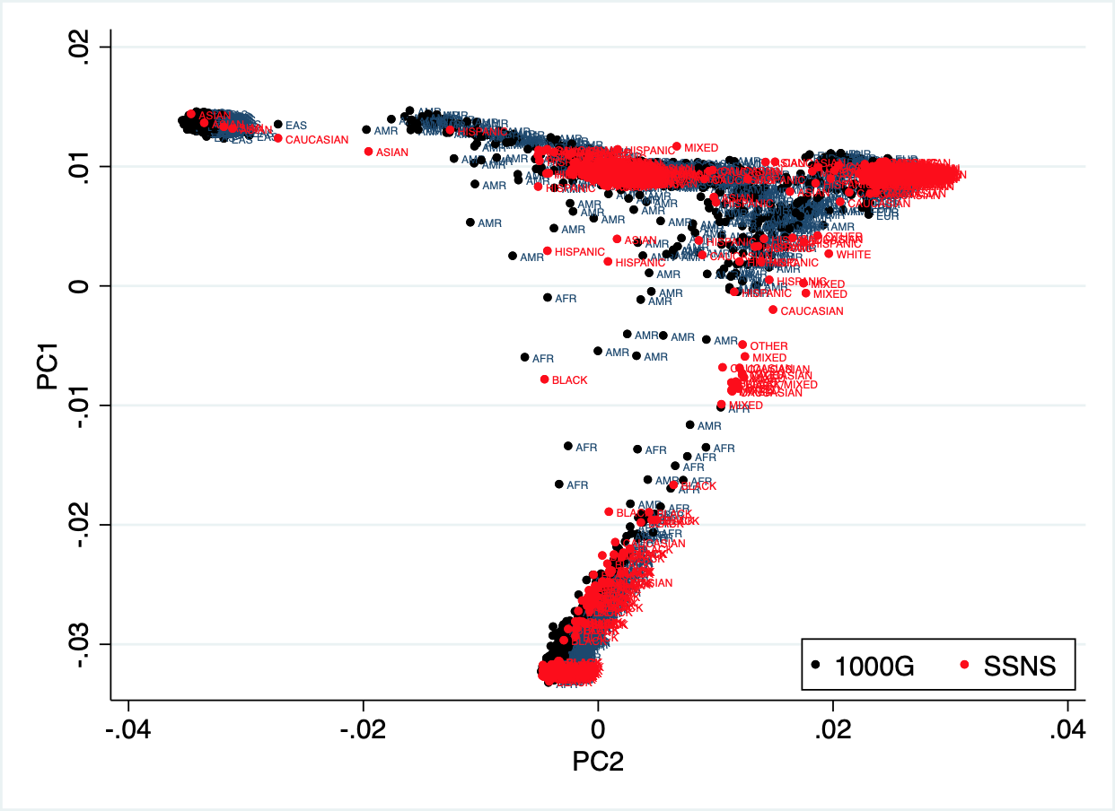
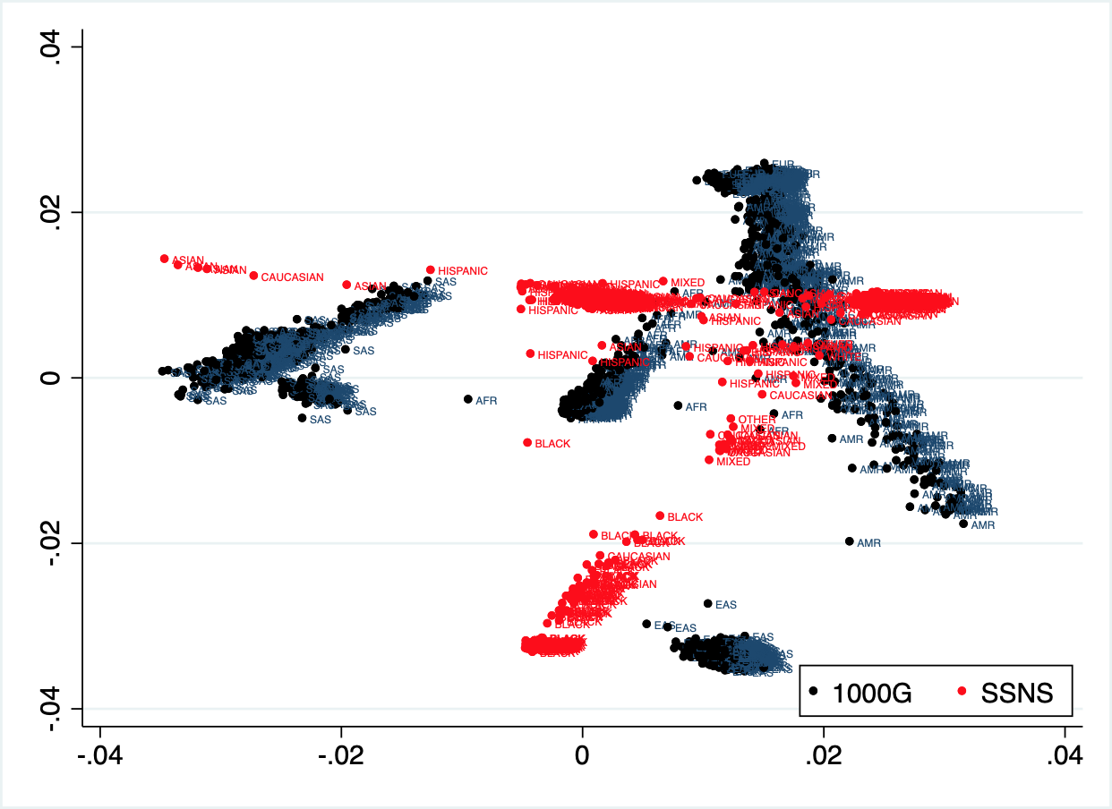
PCA check of SSNS samples vs 1000G pre-selection of controls

Slide 8
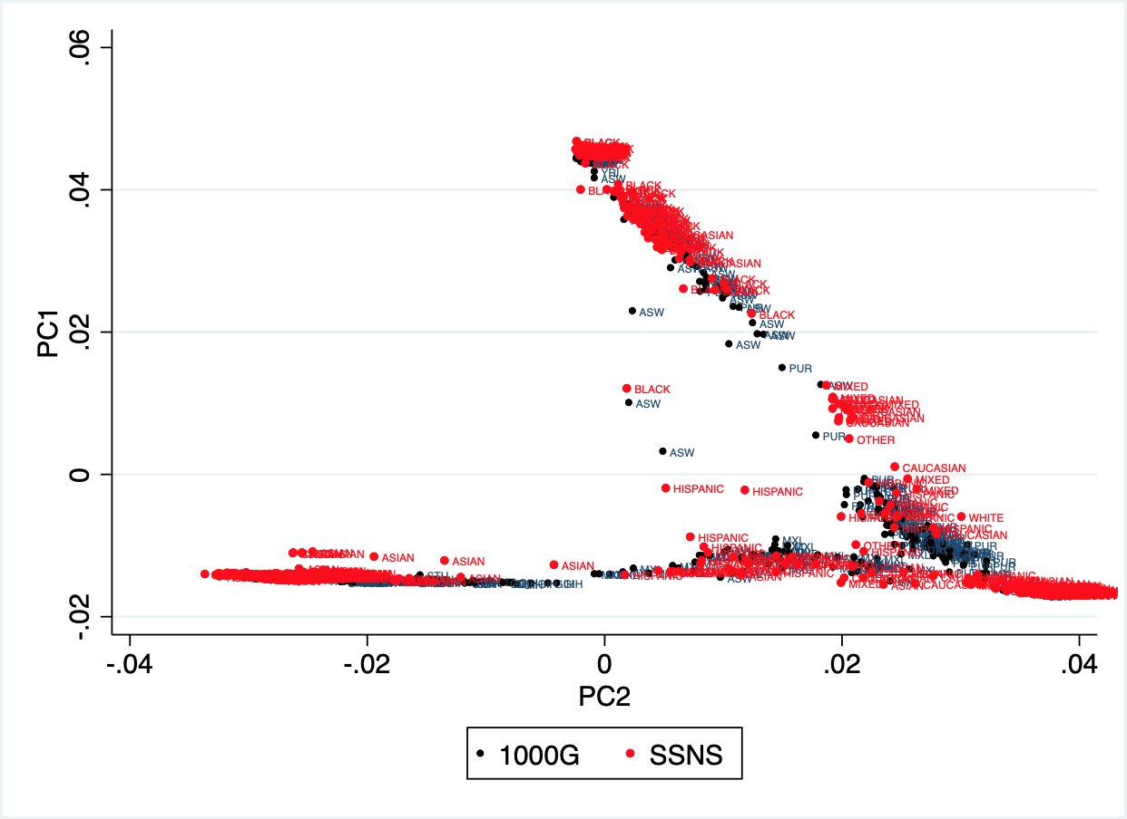
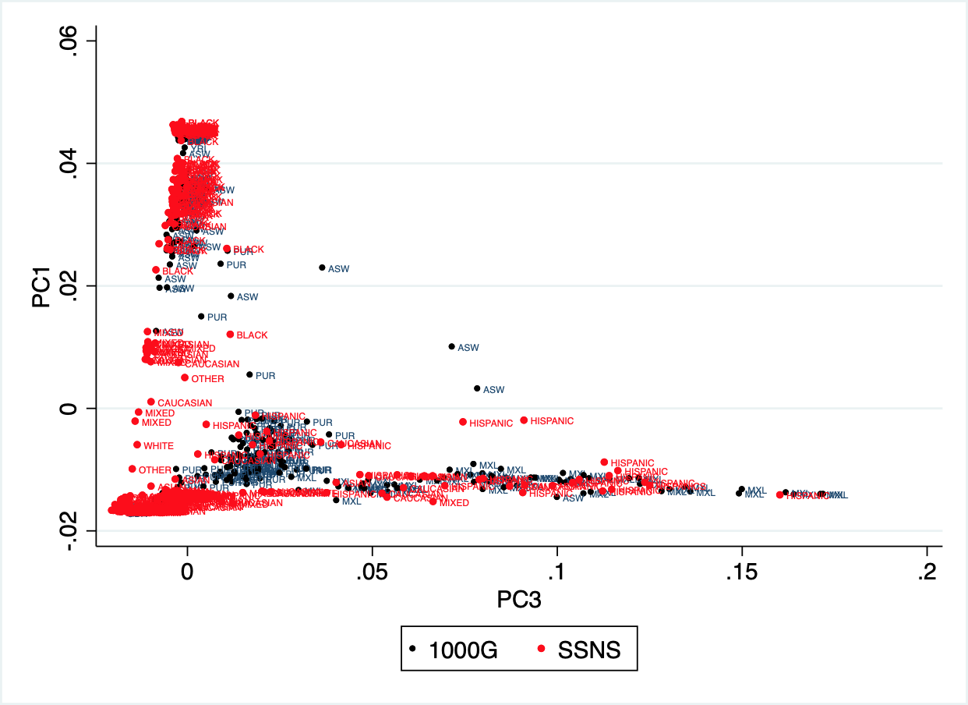
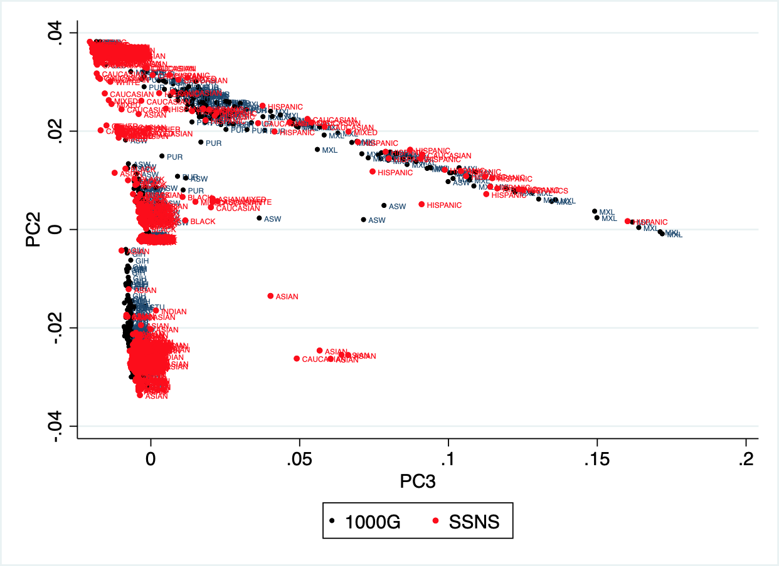
PCA check of SSNS samples vs 1000G: post-selection of controls

Slide 9
Post-selection of controls after PCA check
Group | Cases | Controls | Comments
Asian | 383 | 307 | Controls are SAS [STU, ITU, GIH]
European | 162 | 190 | Controls are EUR [CEU, GBR]
African | 154 | 268 | Controls are AFR [YRI, ESN, ASW]
Admixed | 57 | 168 | Controls are AMR [MXL, PUR]
All | 756 | 933

Slide 10
SSNS GWAS: Exploratory data analysis
Pre-imputation QC with Rayner’s HRC-1000G imputation preparation and checking toolbox and appropriate ancestry specific reference
Genotype data imputation using Michigan Imputation Server
1000 Genomes reference imputation panel
Variants imputed with high quality - R² >= 0.3 - analyzed

Slide 11
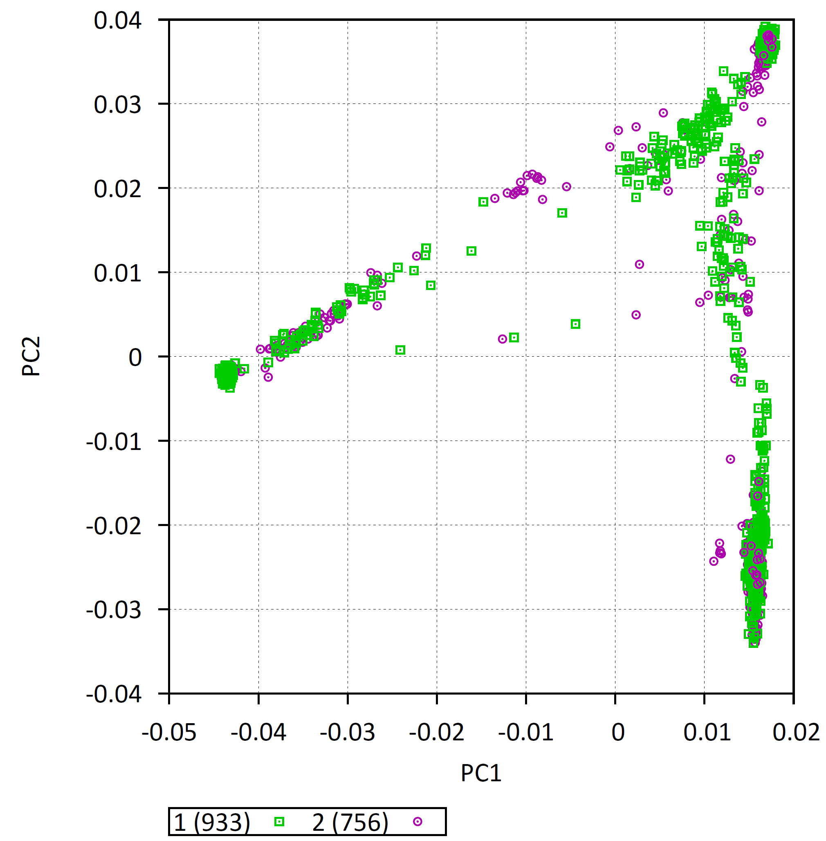
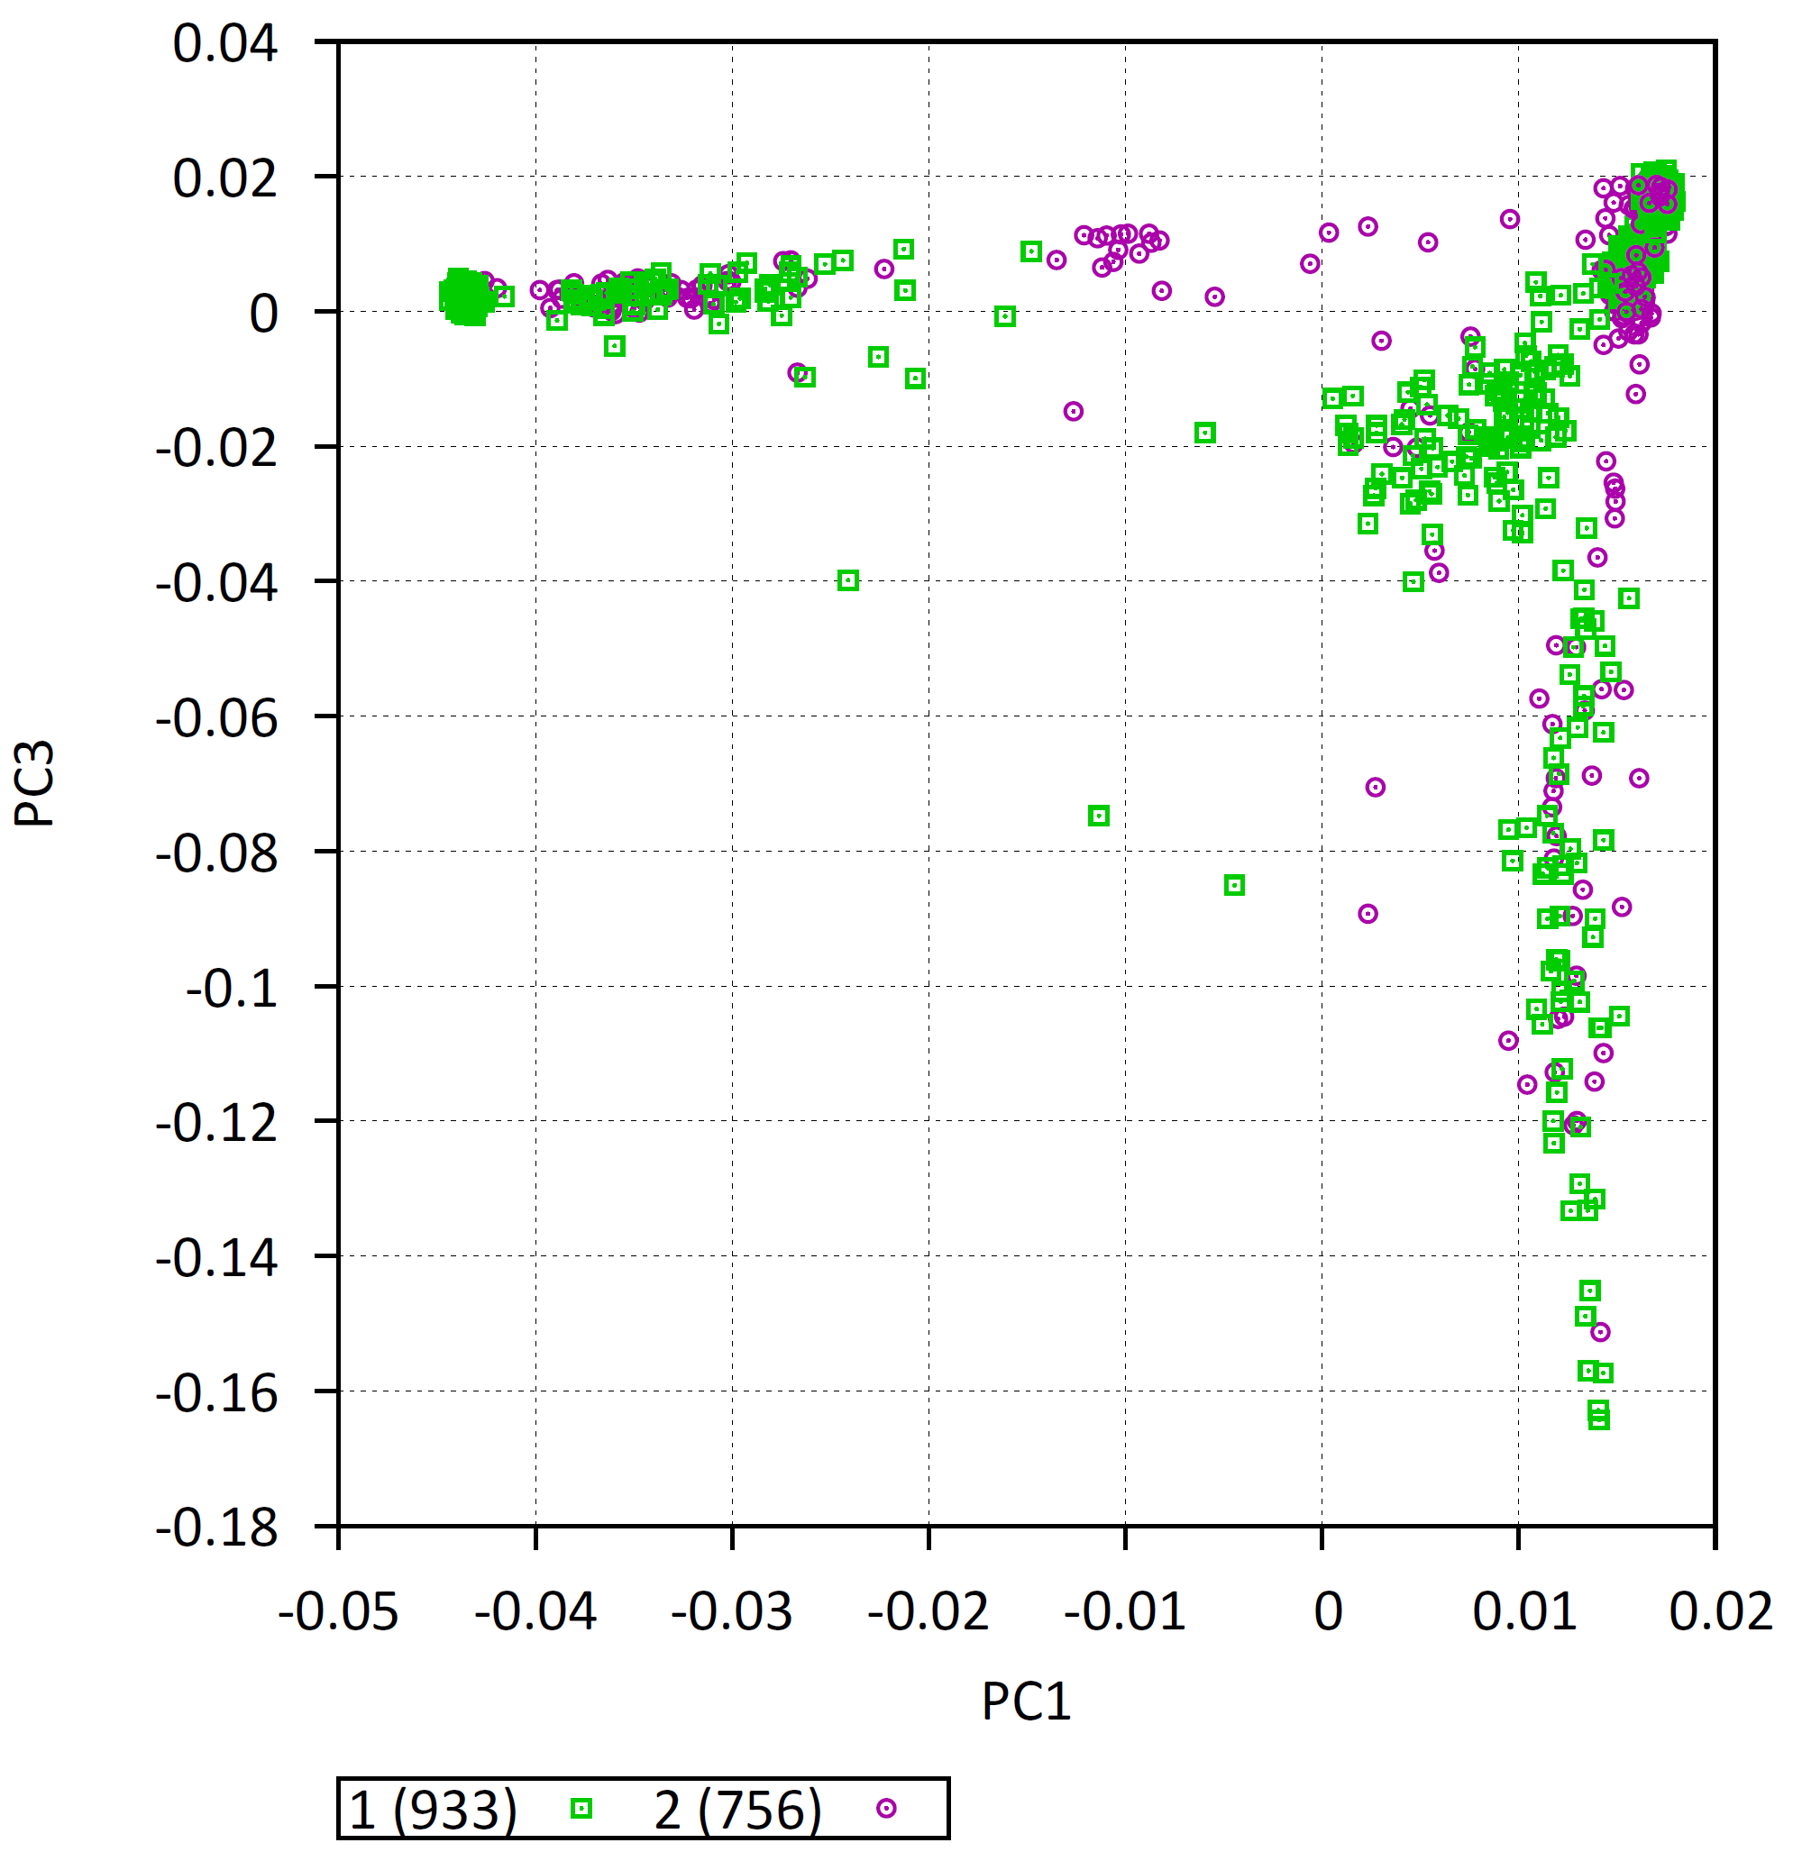
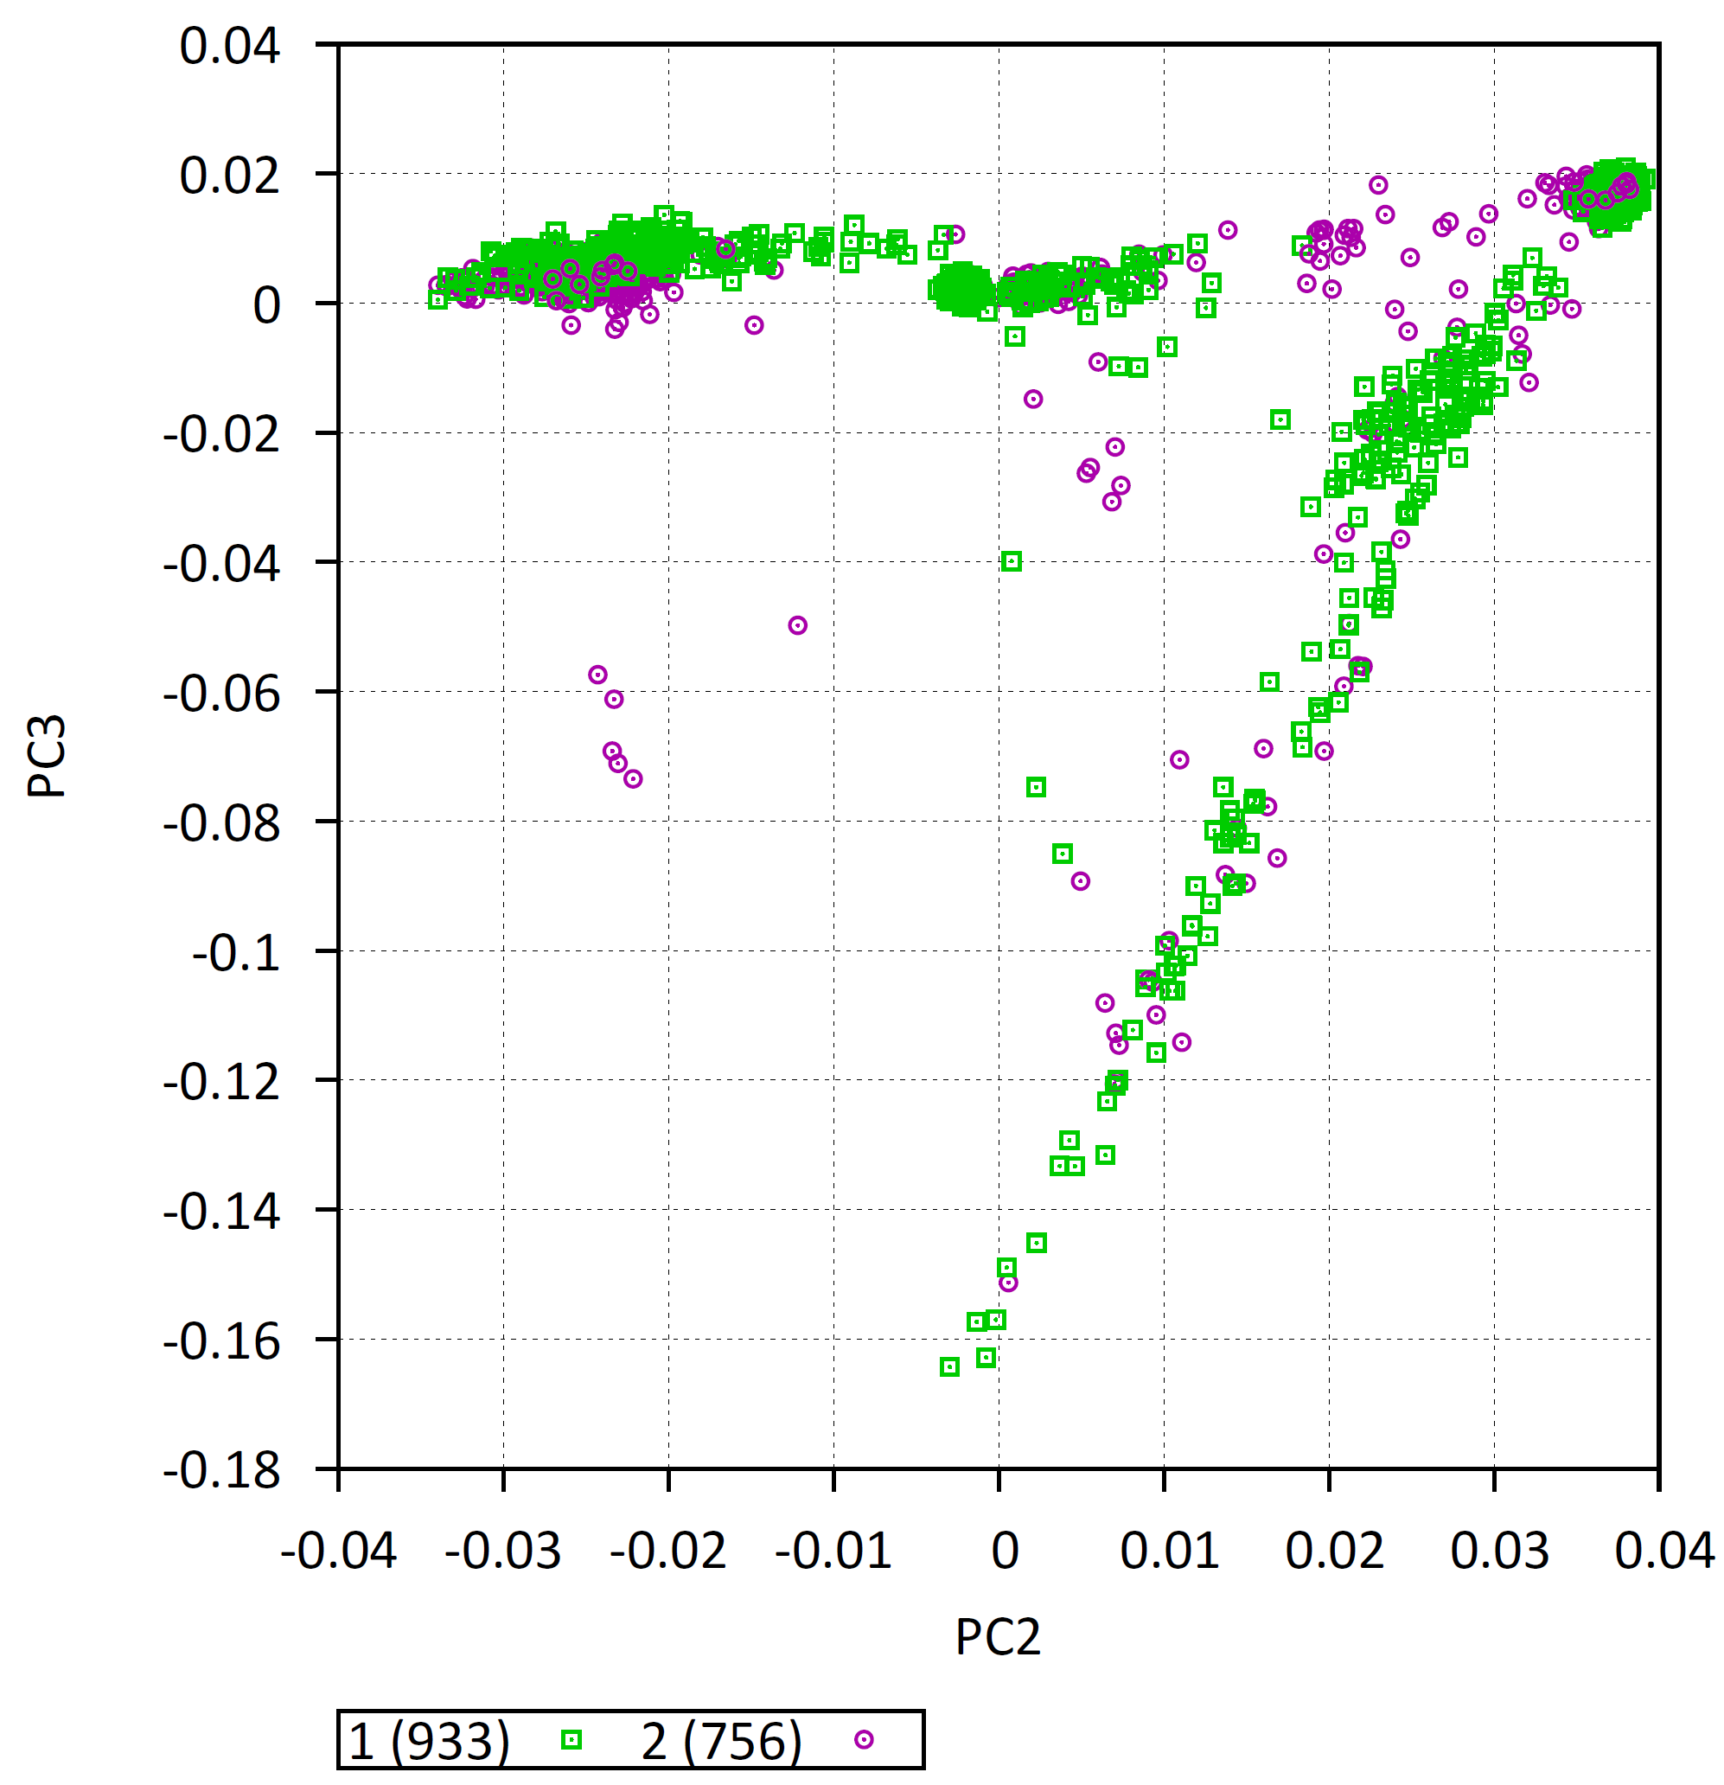
PCA plot: all cases and controls

Slide 12
Association analysis by ancestry group

Slide 13
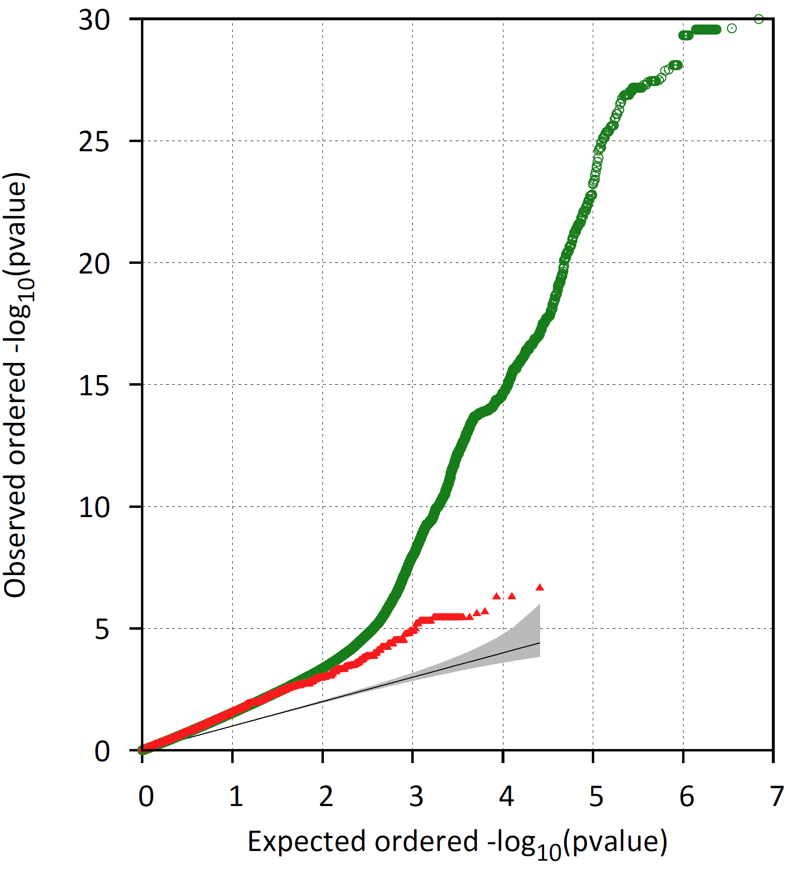
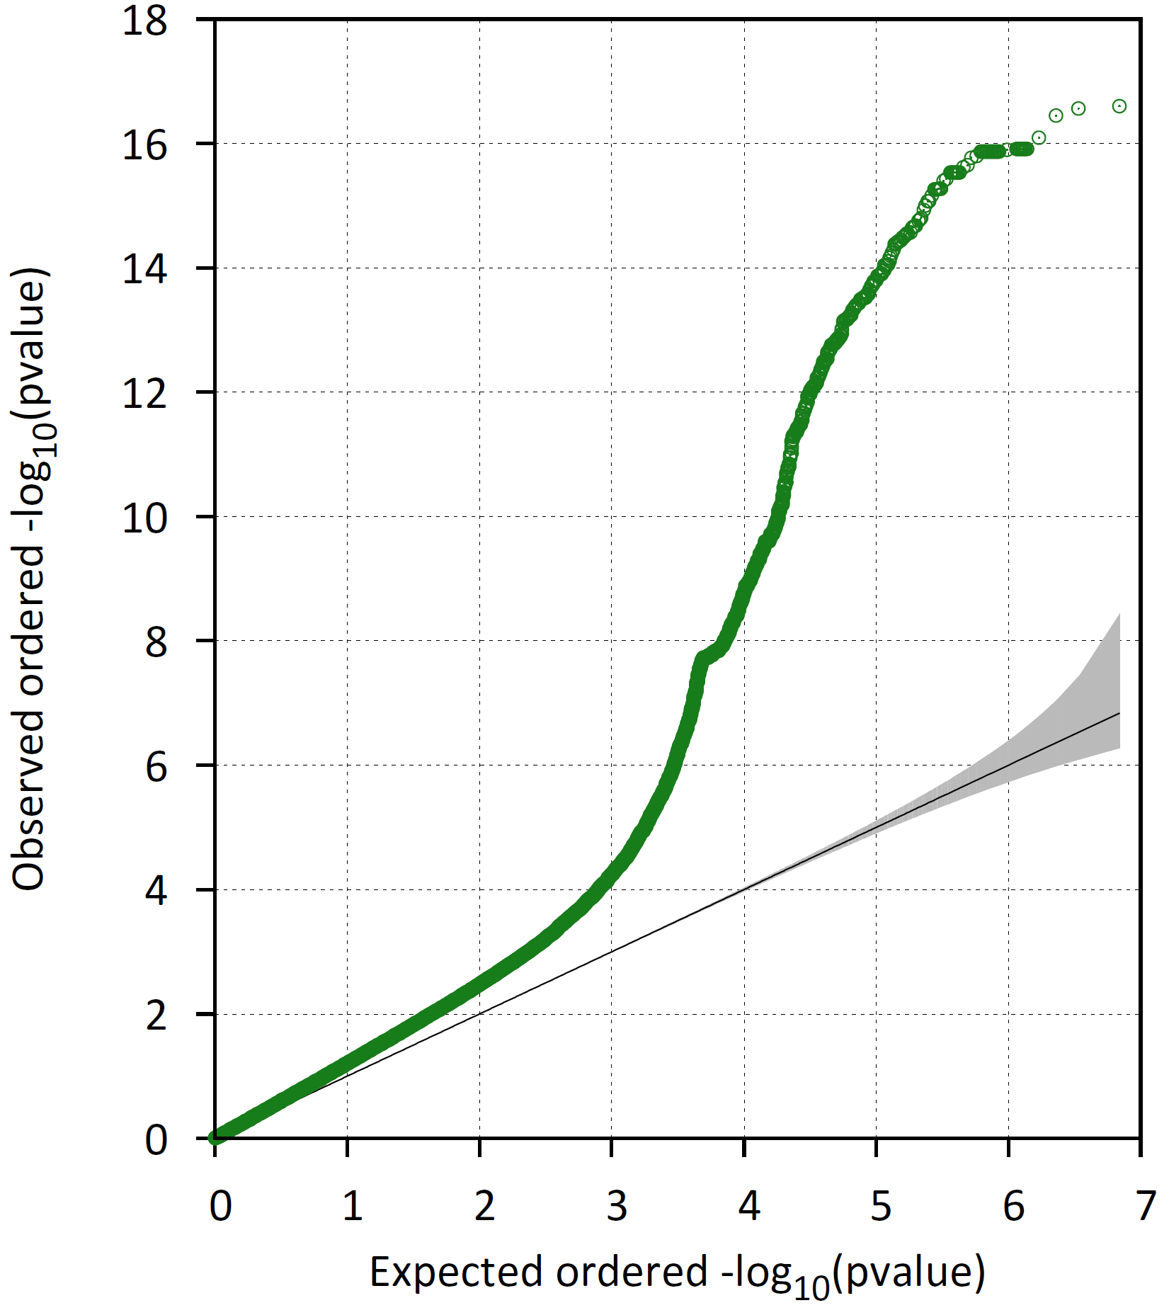
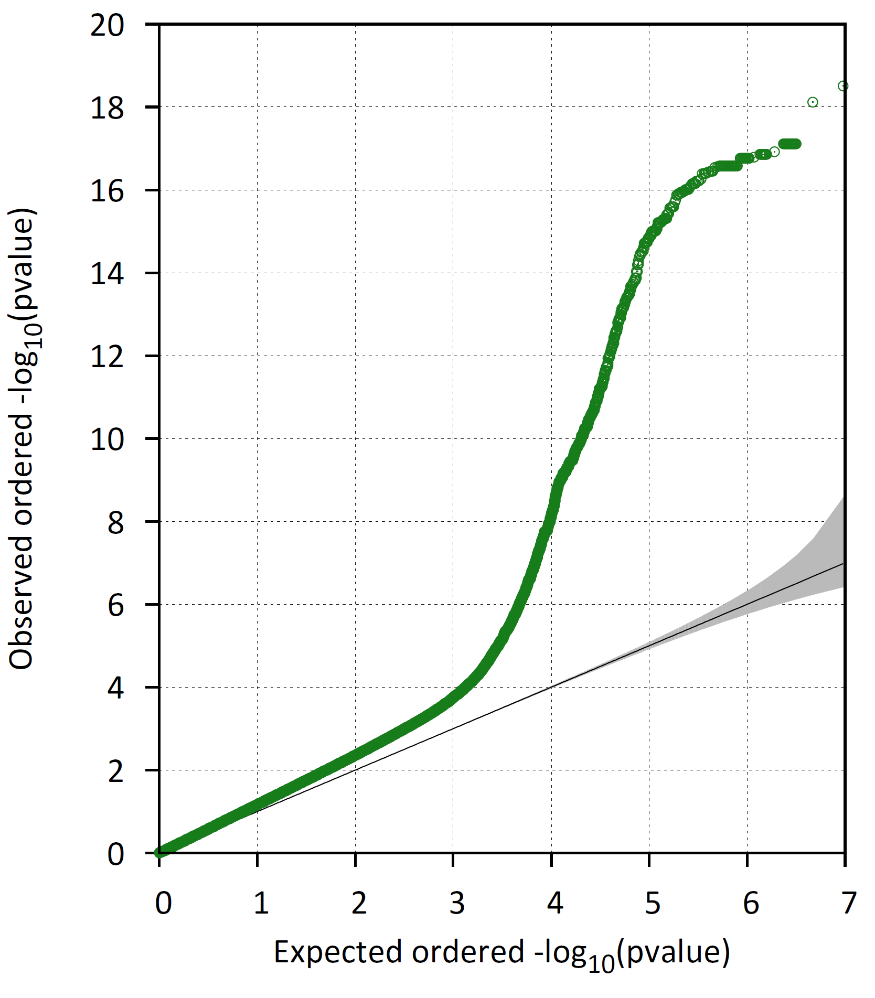
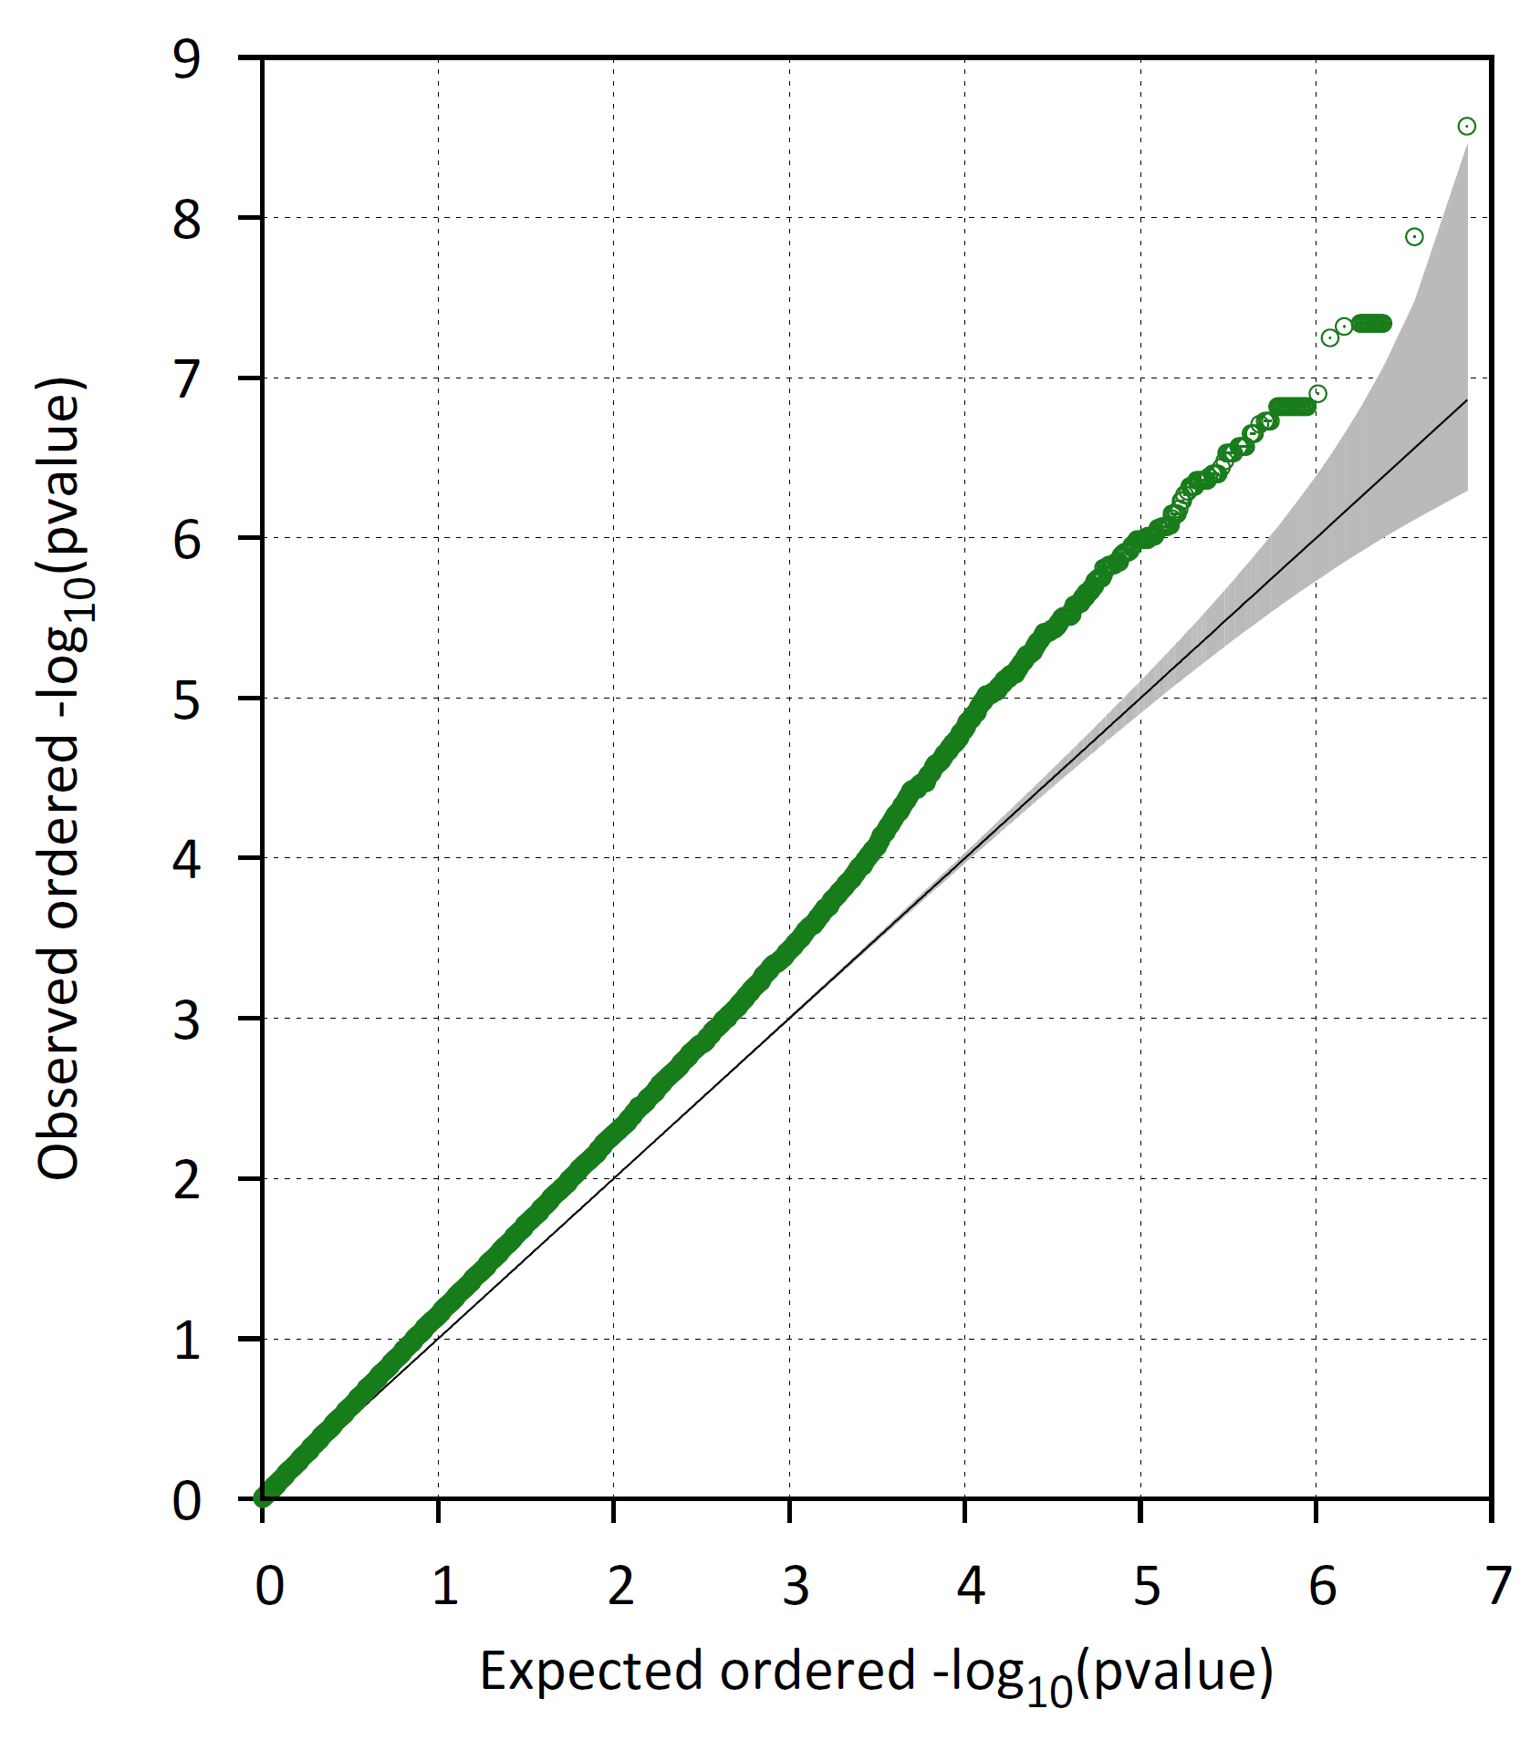
Association analysis per pop [MAF >= 0.05, no covariates, logistic model, Wald test]
Asian
European
African
Mixed
Notes:
Inflation of test statistics in all groups, worst in the Asian group

Slide 14
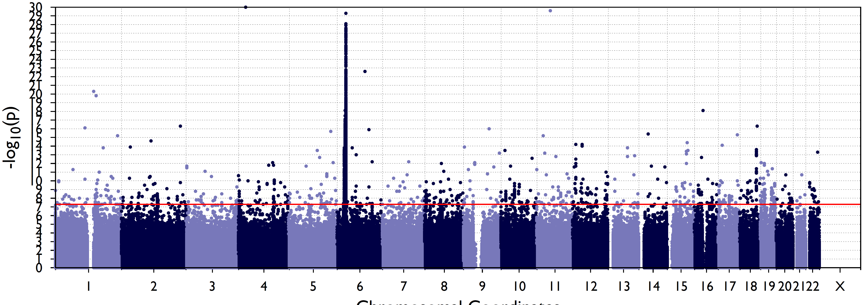
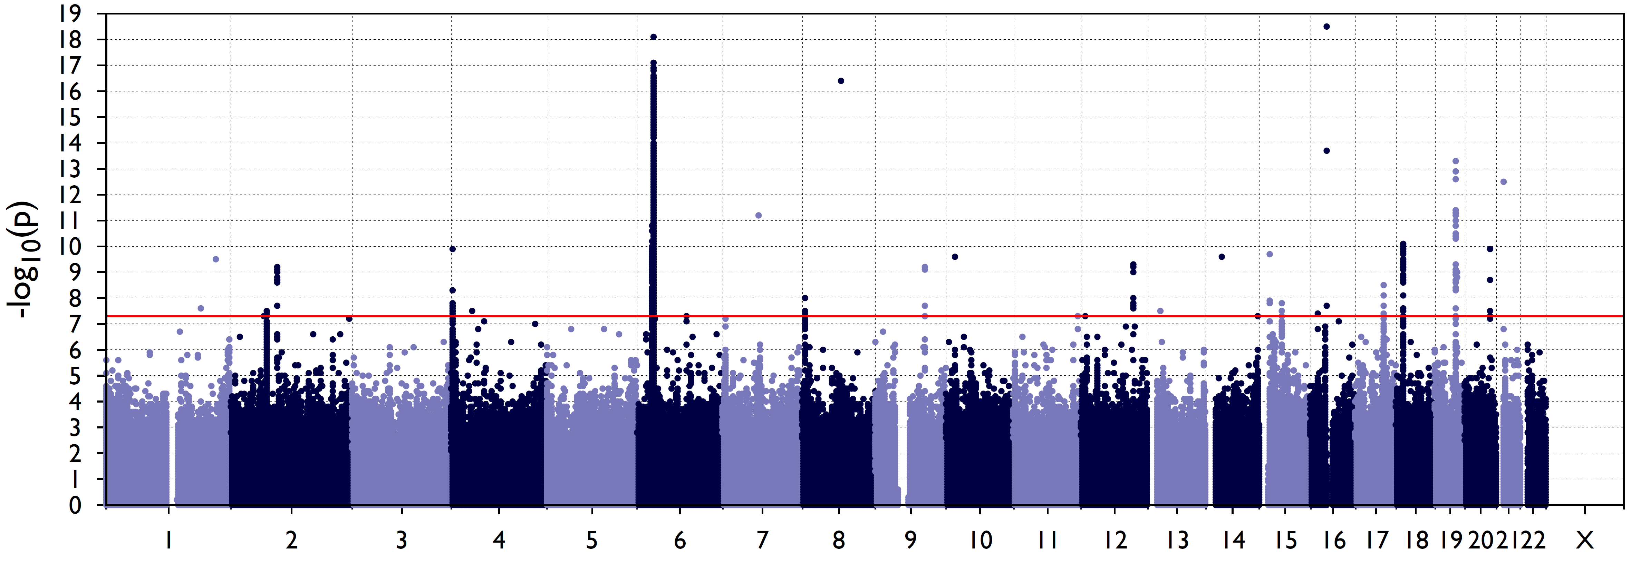
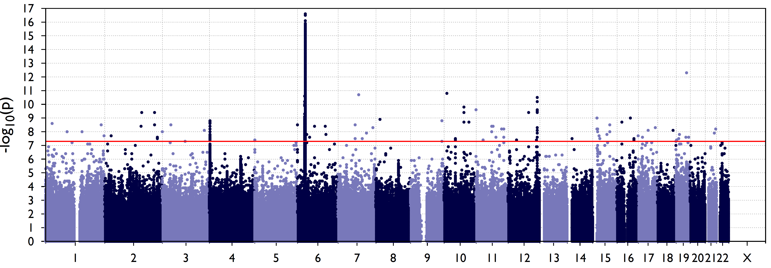
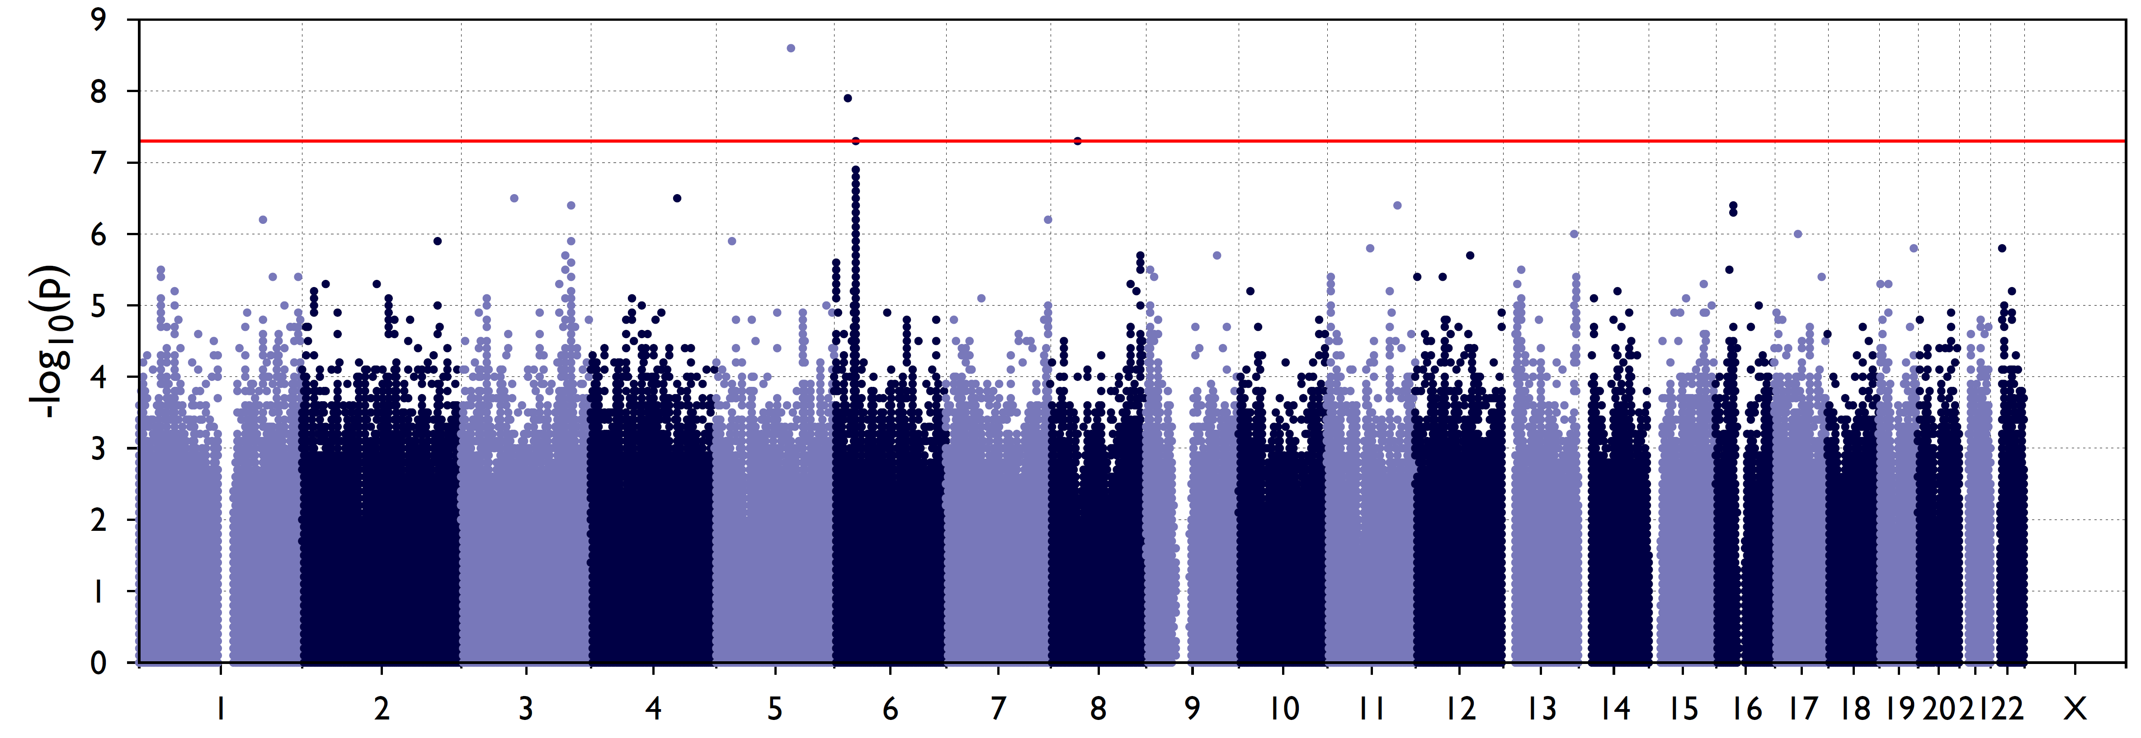
Association analysis per pop [MAF >= 0.05, no covariates, logistic model, Wald test]
Asian
African
European
Mixed

Slide 15
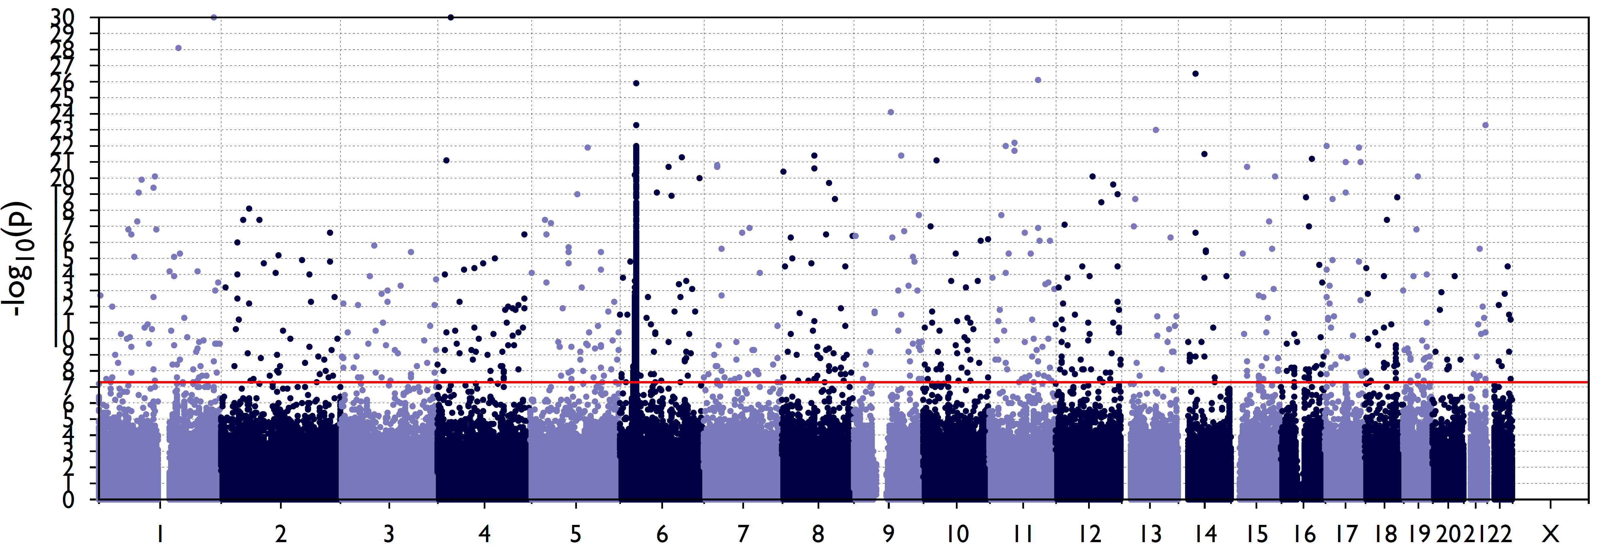
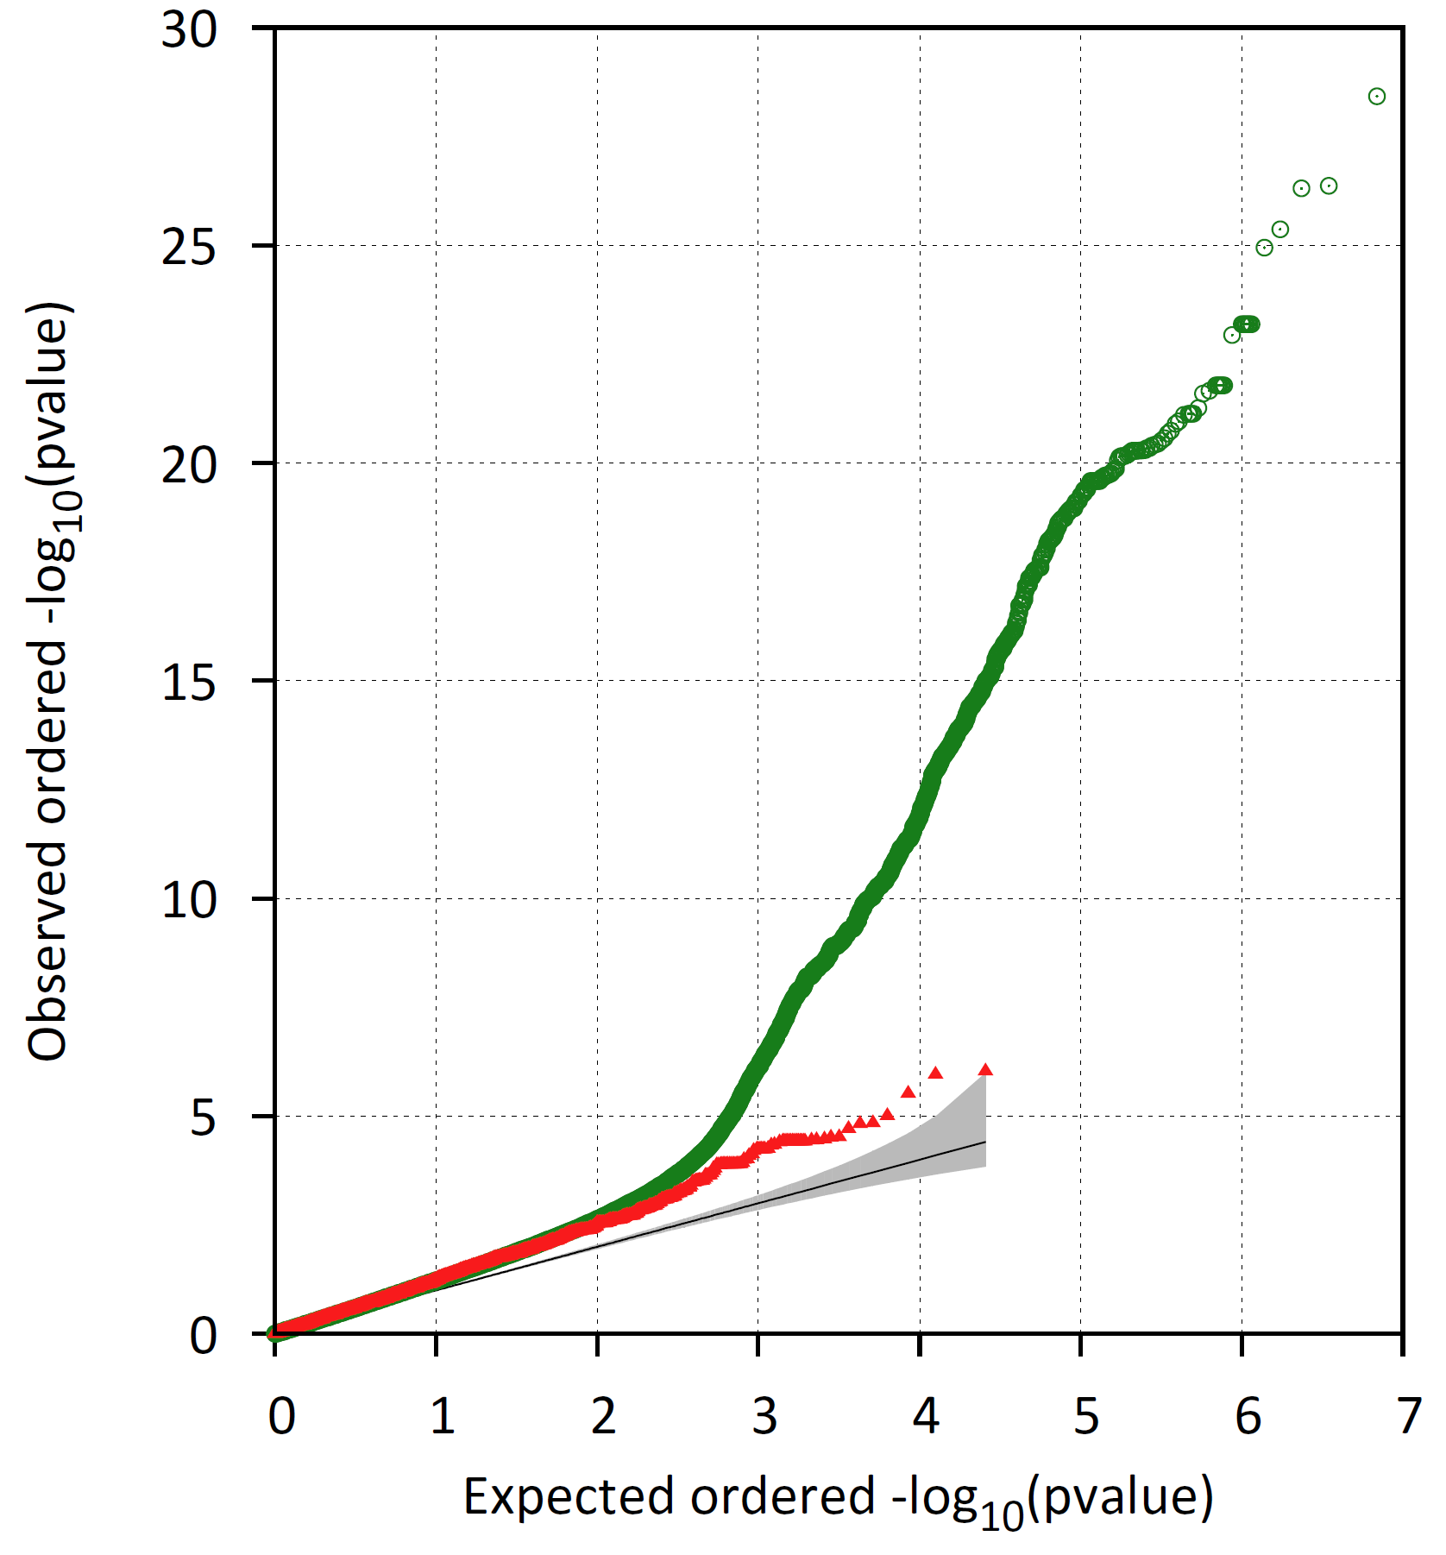
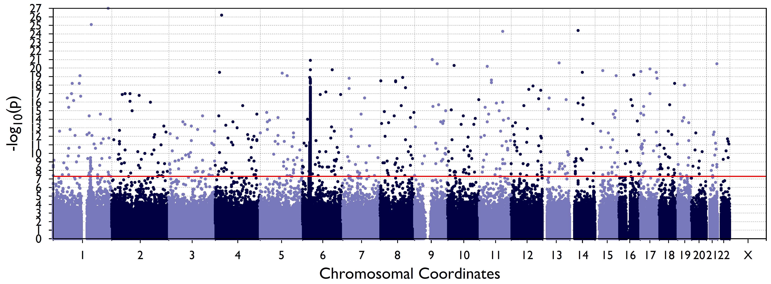
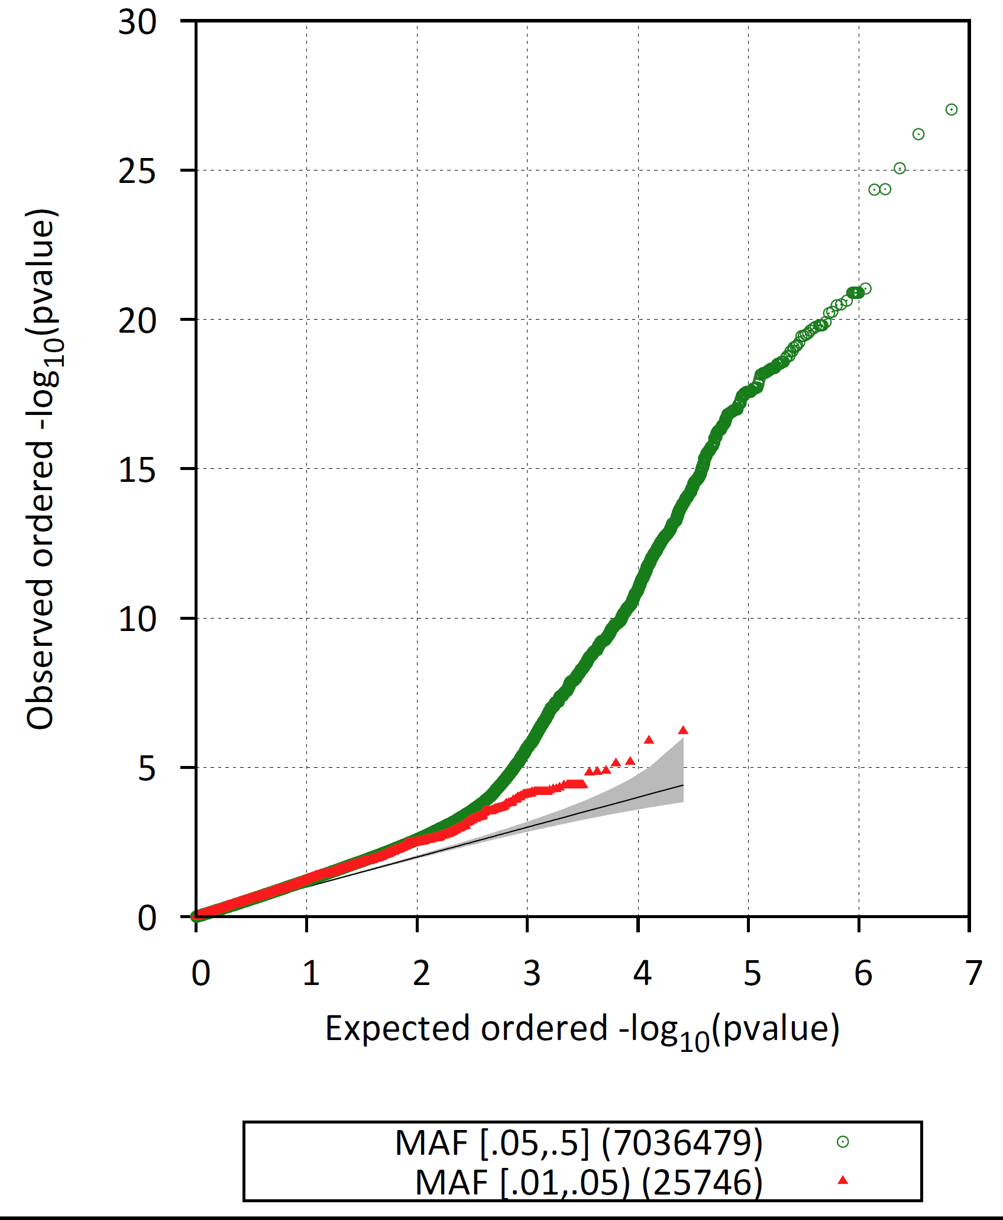
Asian ancestry: Association [Wald test]
Adjusted for
1 PC
3 PCs
5 PCs
Notes:
QQ plot show inflation of test statistics not controlled after adjusting for first 5 PCs. Note: this is the subgroup with the worst case-control imbalance: 383 cases, 307 controls

Slide 16
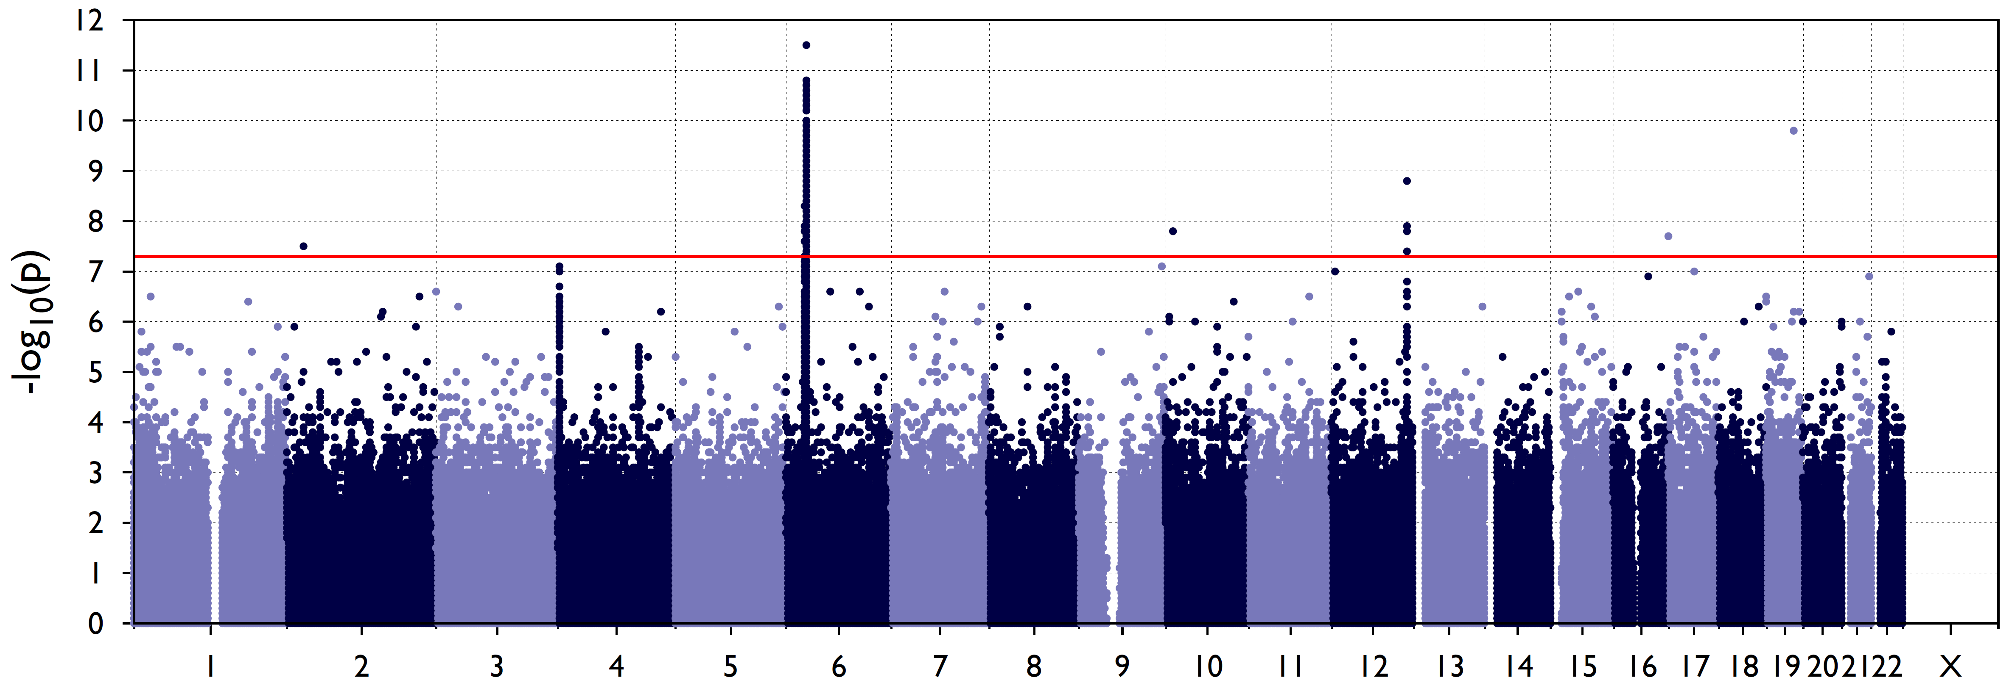
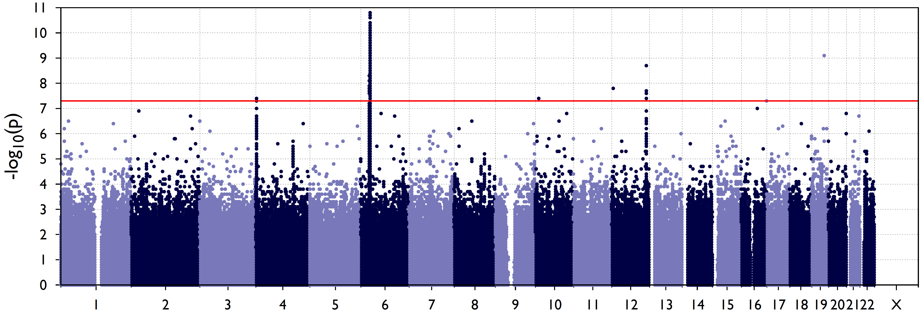
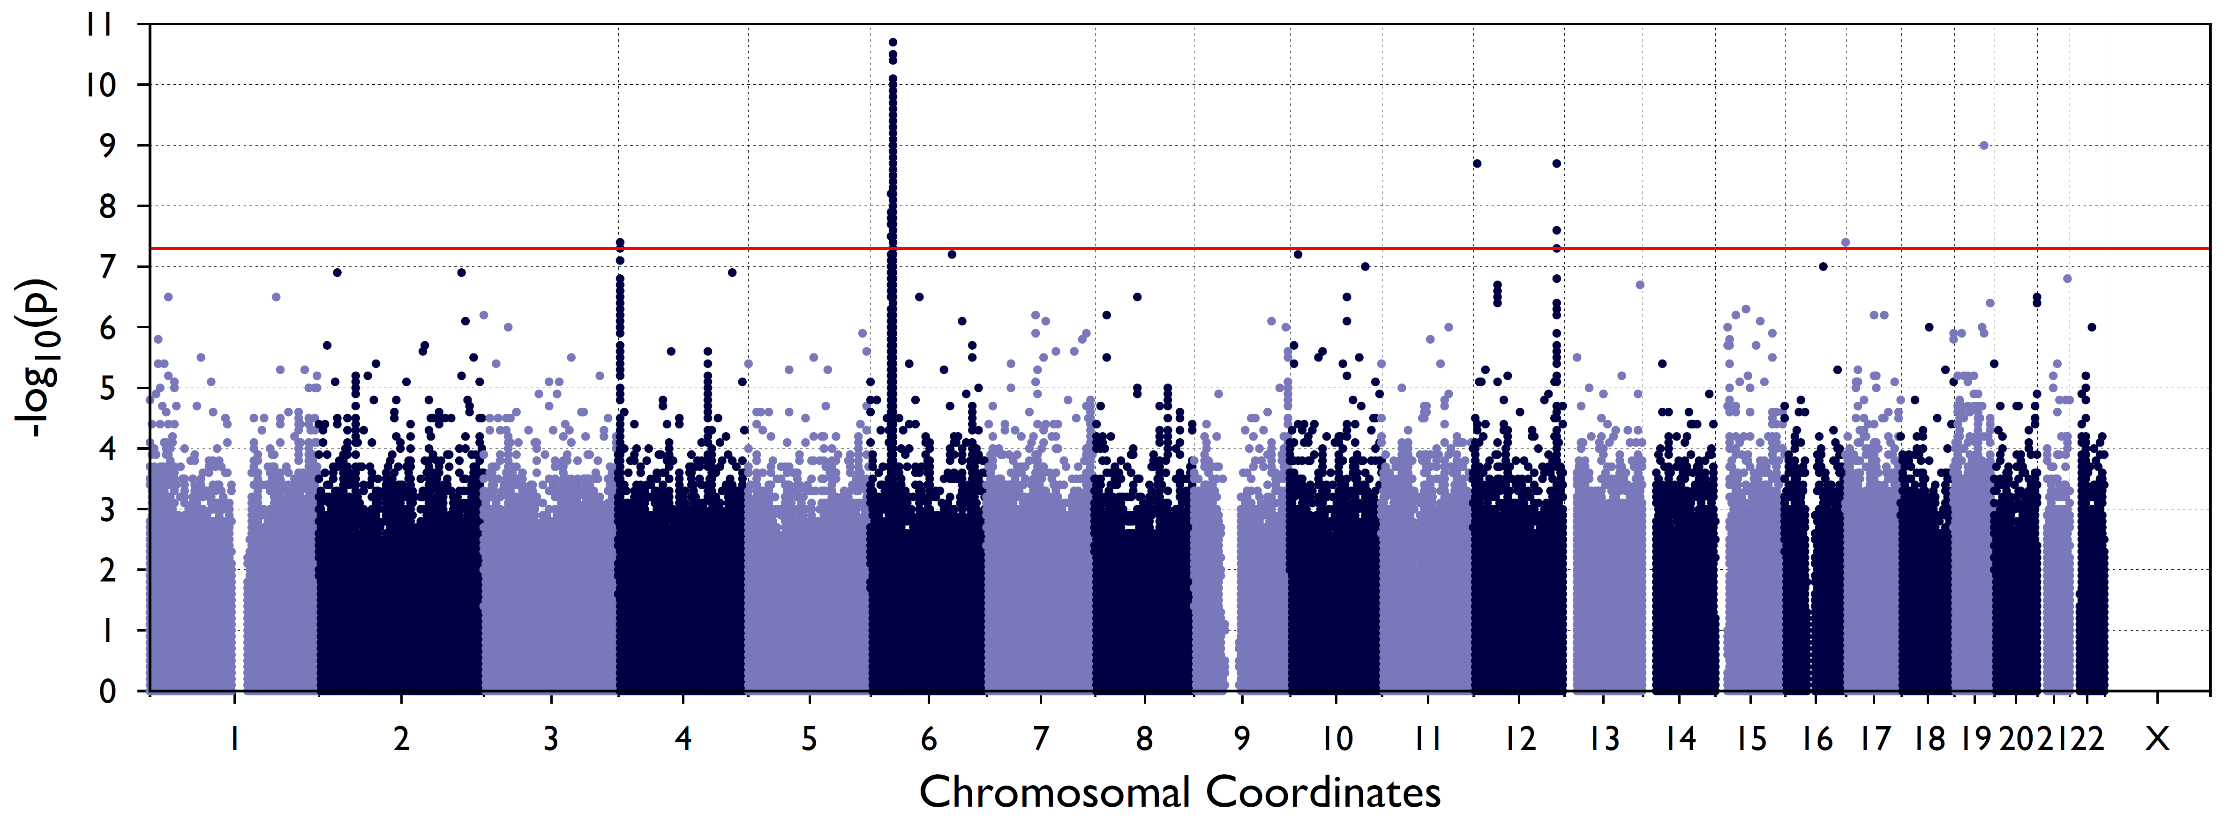
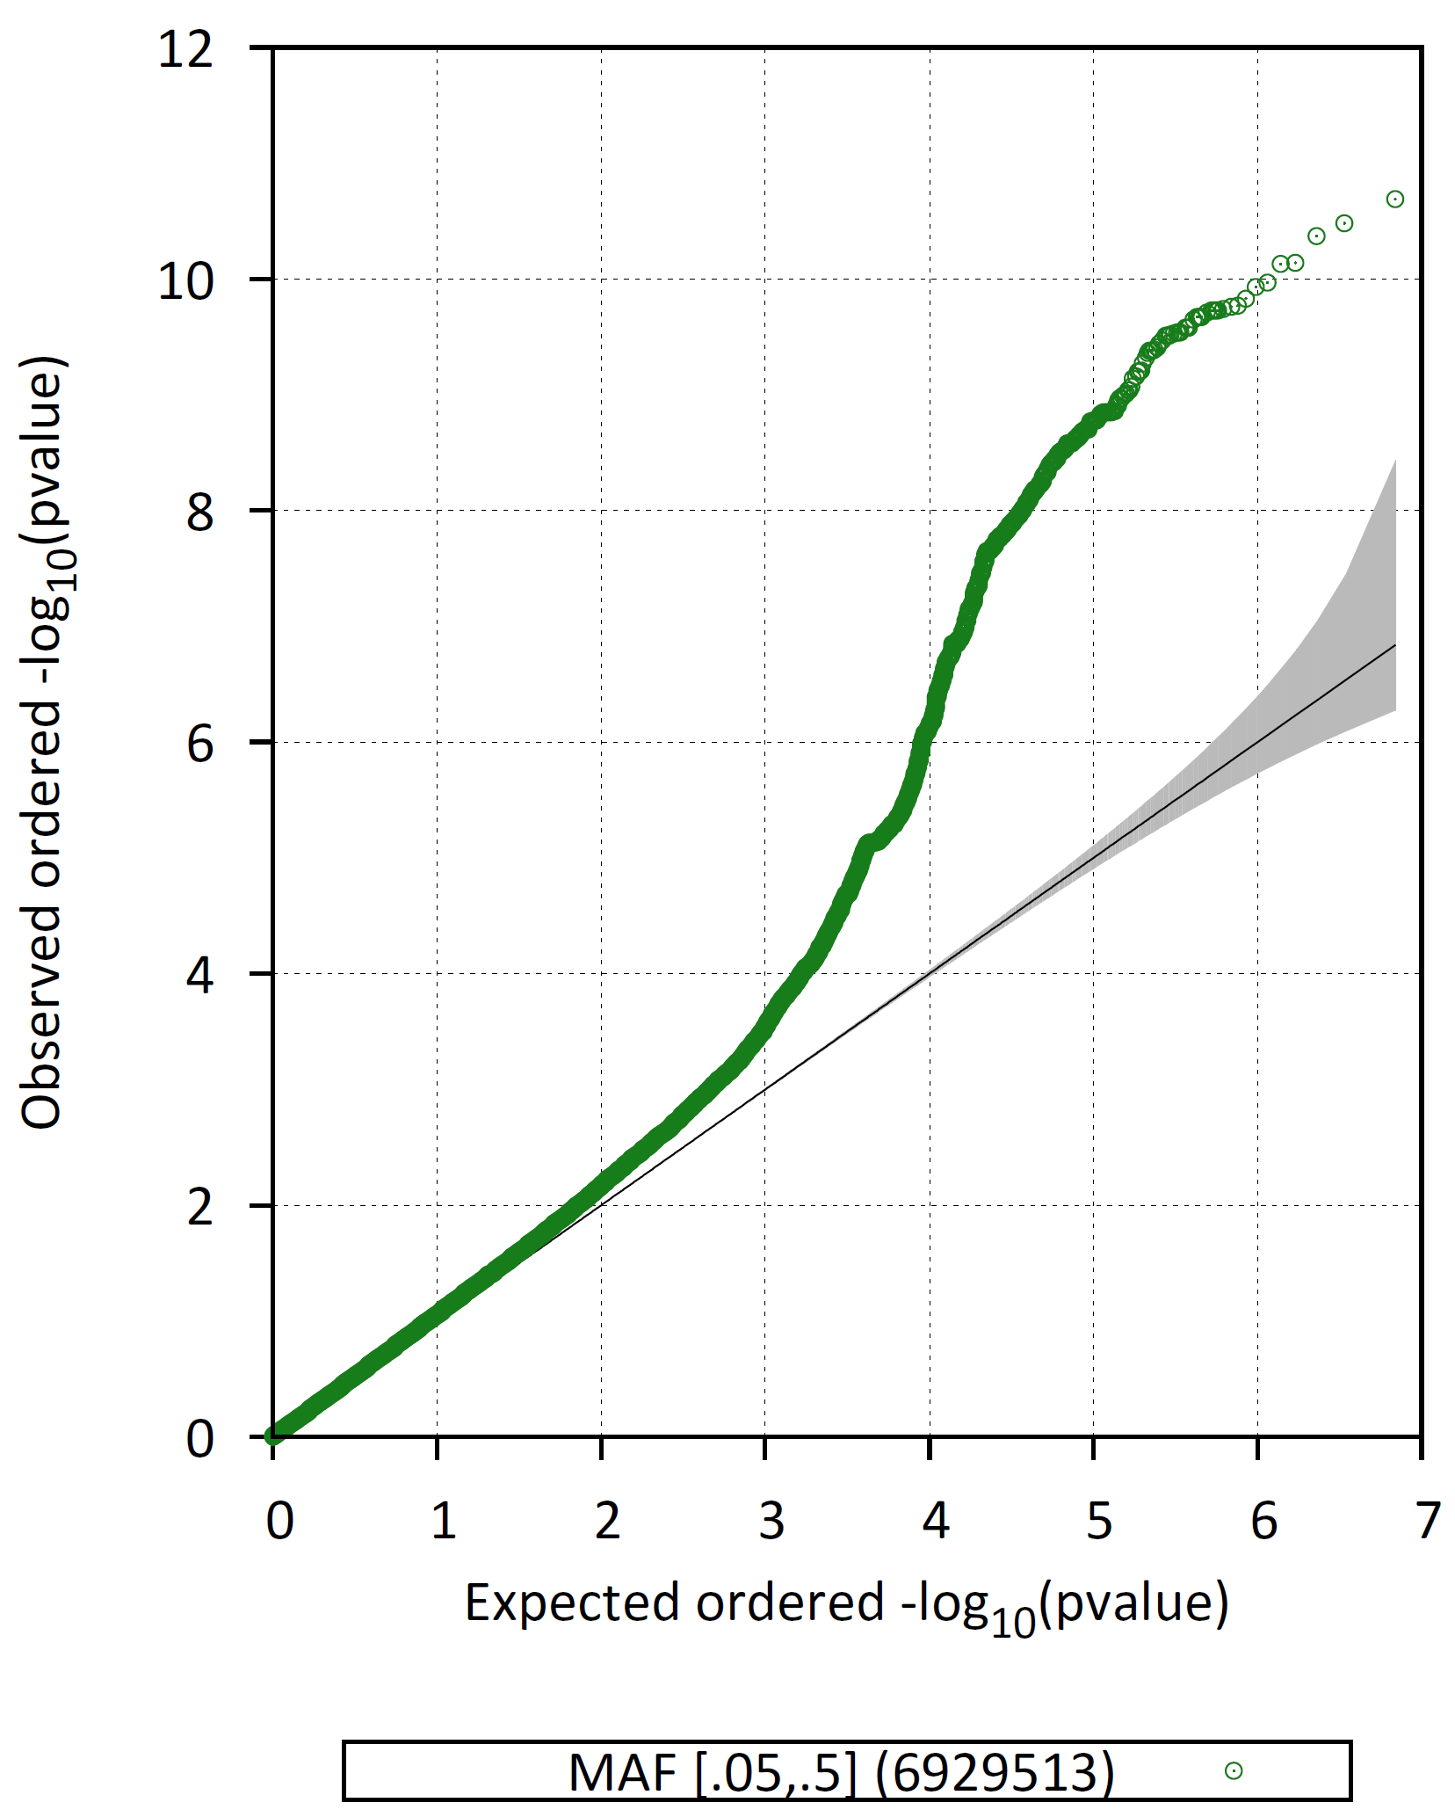
European ancestry: Association [Wald test]
Adjusted for
1 PC
3 PCs
5 PCs
Notes:
QQ plot looks good after controlling for 3 PCs. Two secondary loci: chr4 and chr12

Slide 17
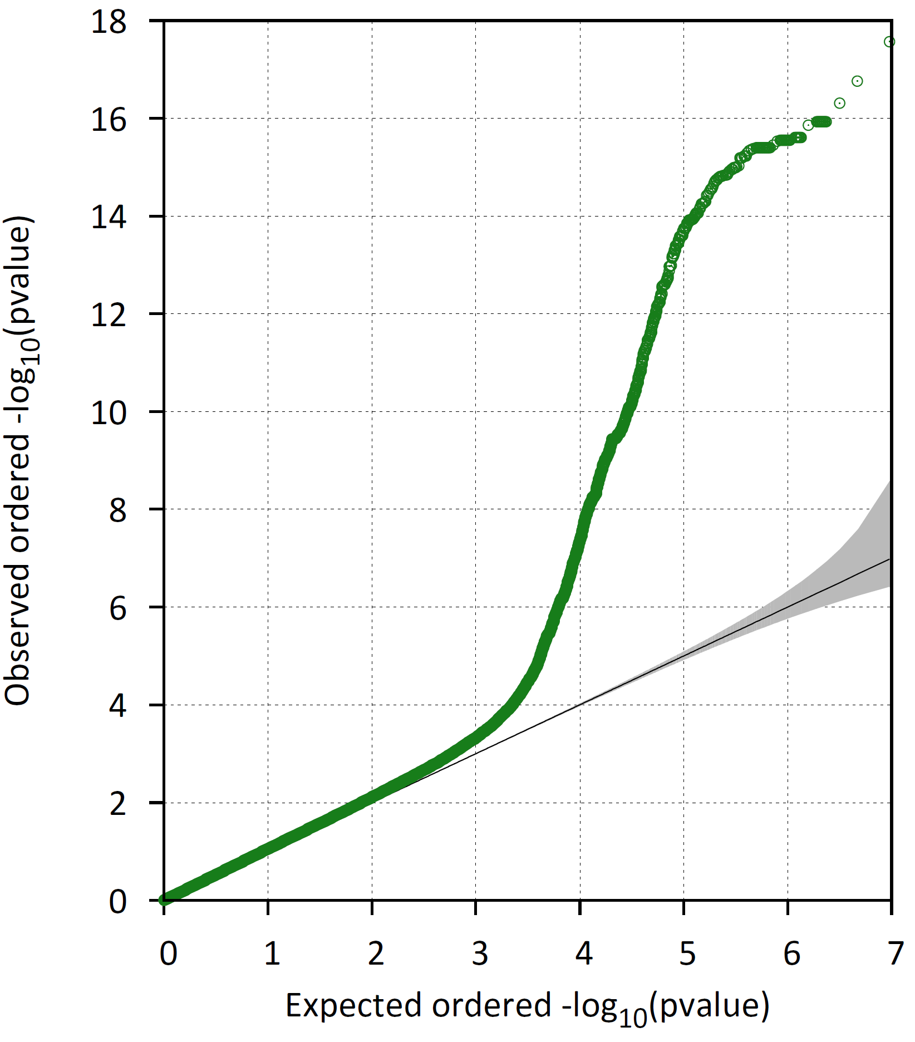
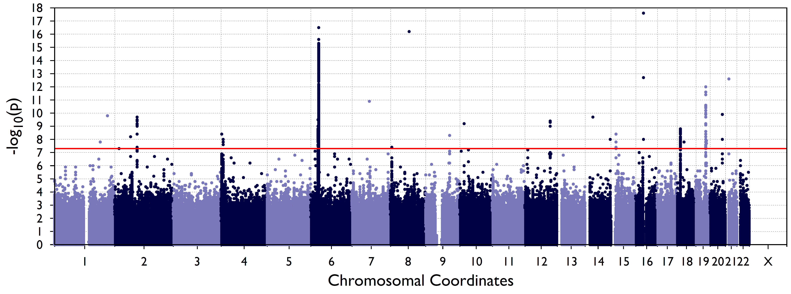
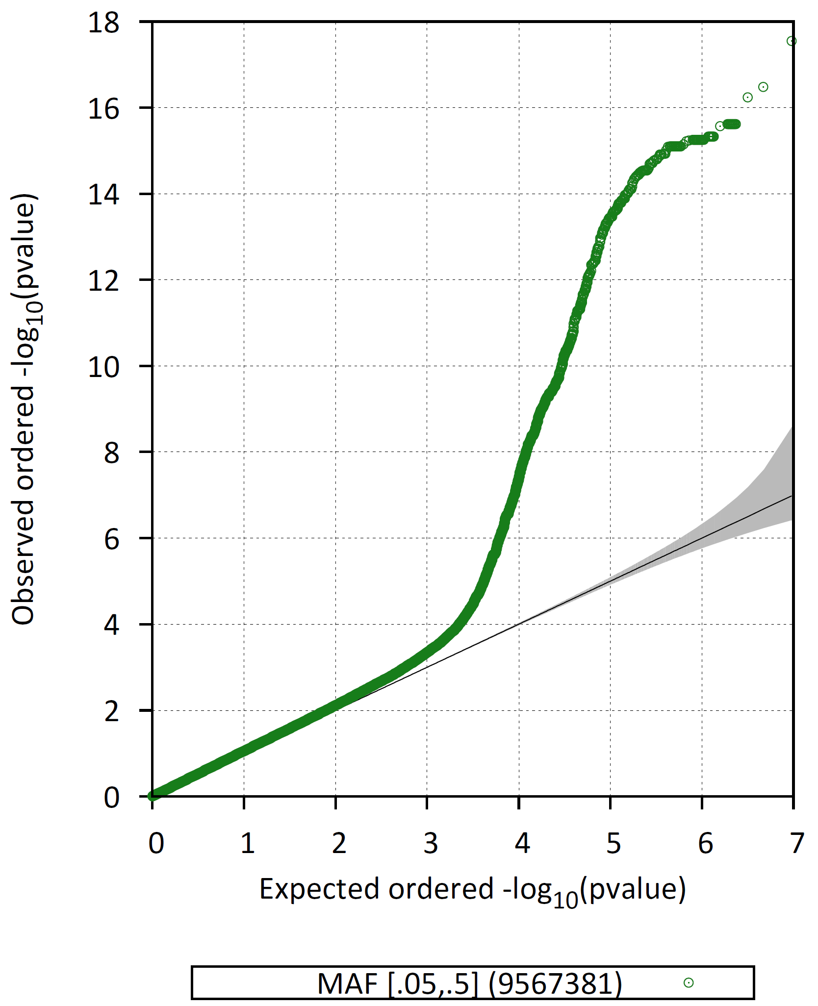
African ancestry: Association [Wald test]
Adjusted for
1 PC
3 PCs
5 PCs
Notes:
QQ plot looks good after adjusting for 1 PC. Secondary loci on chr 2, 4, 15, 18, 19

Slide 18
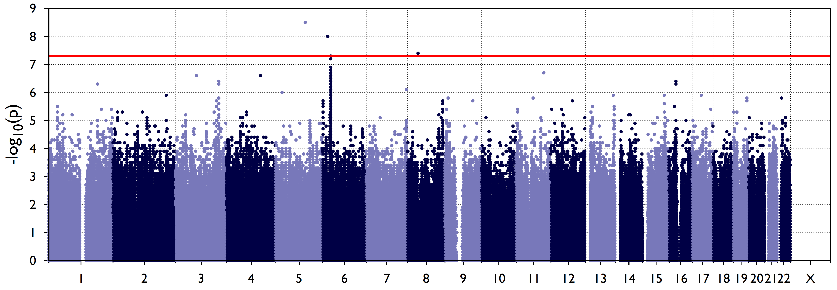
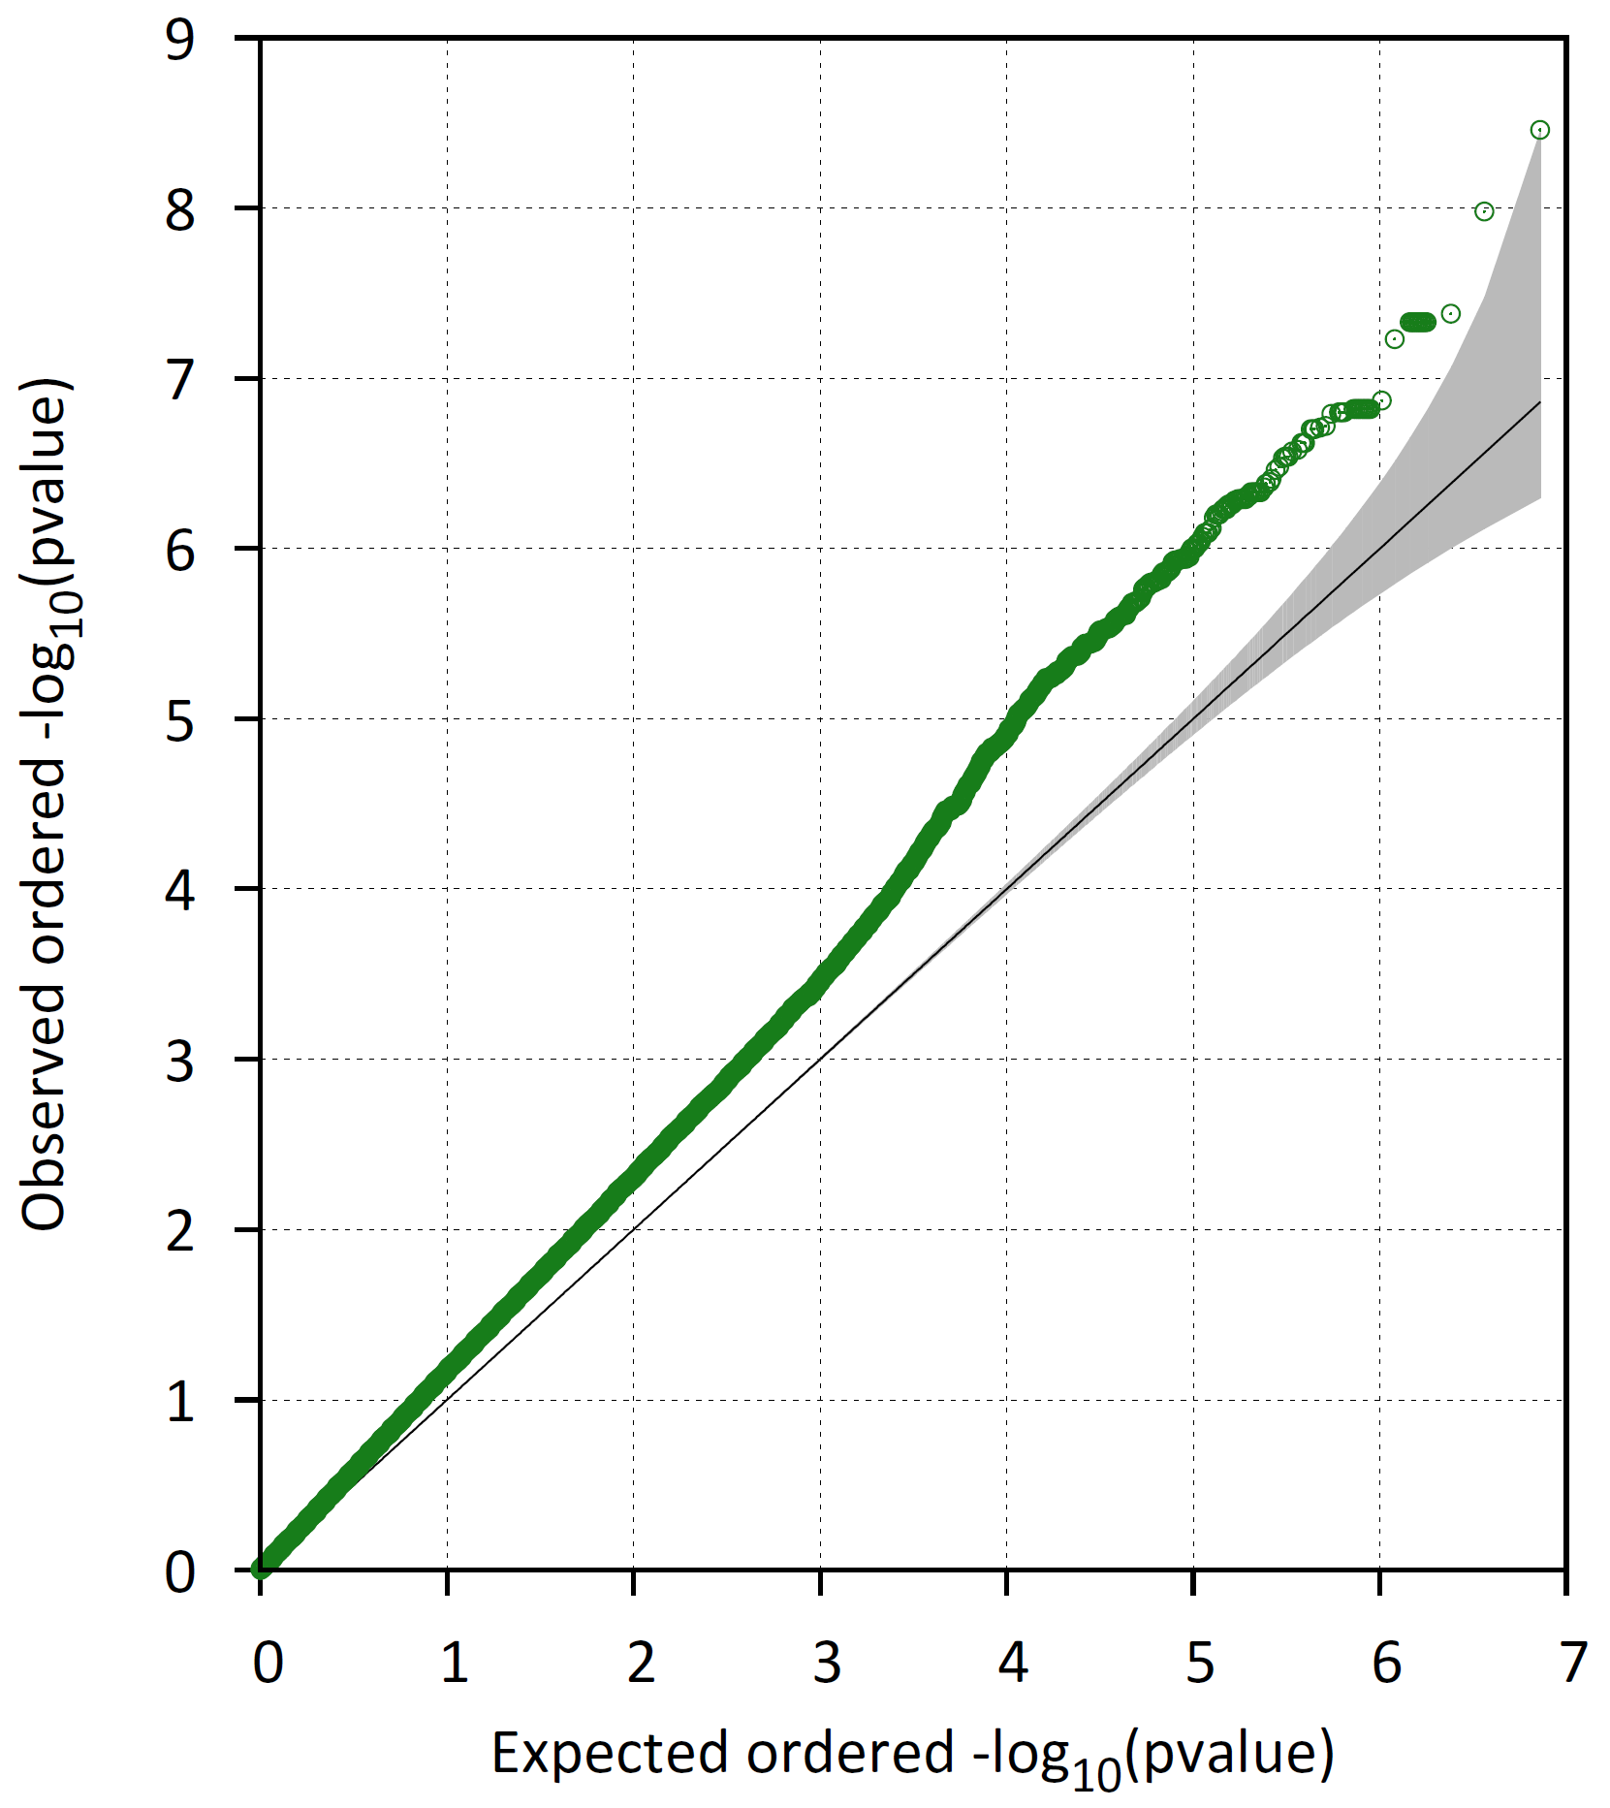
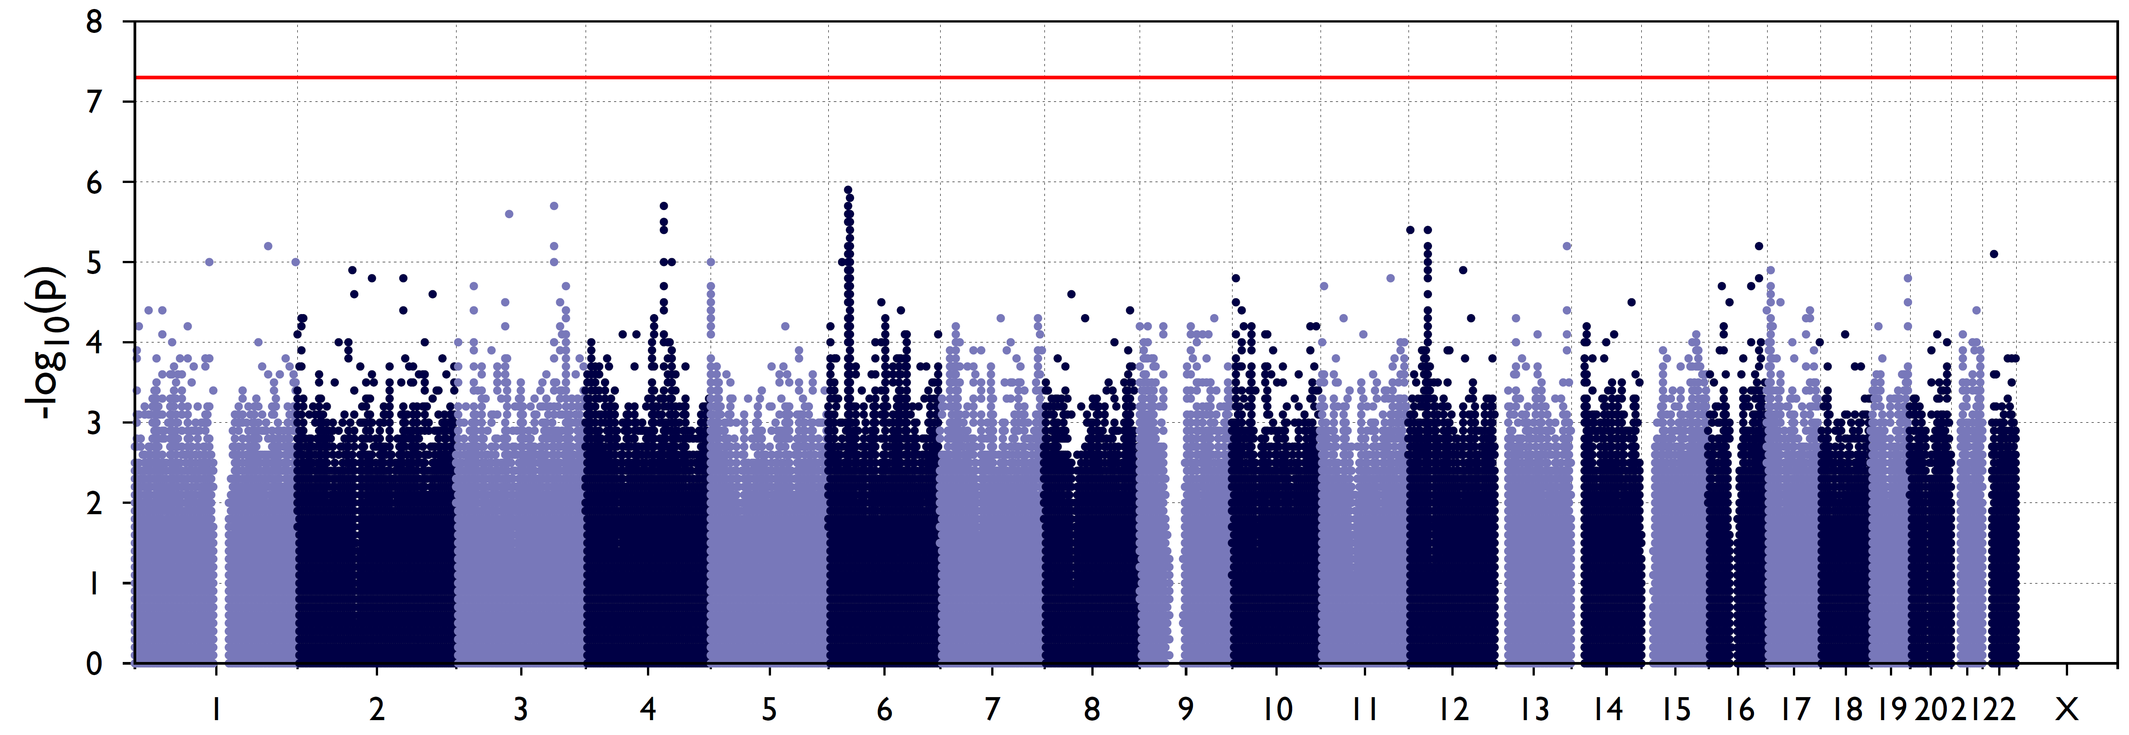
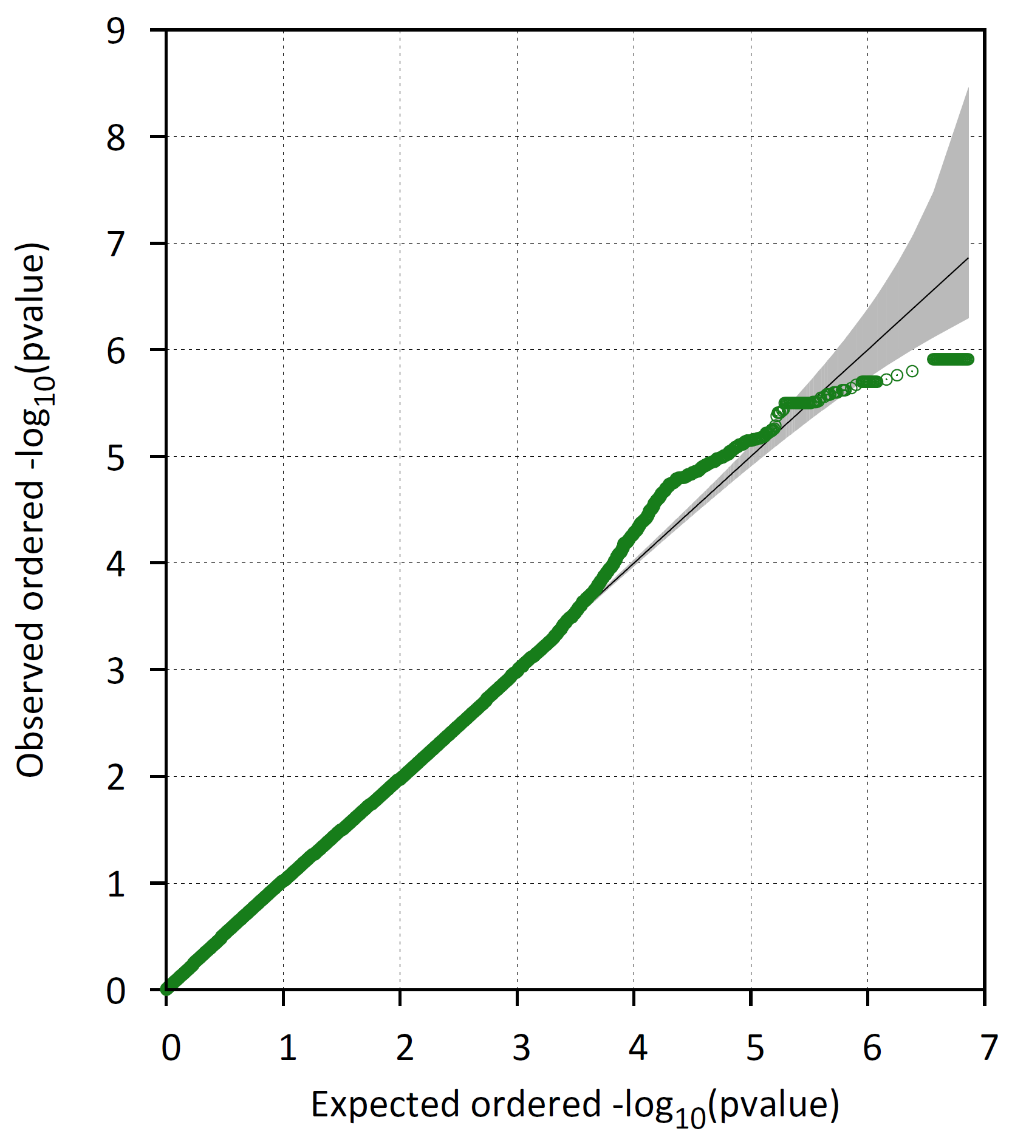
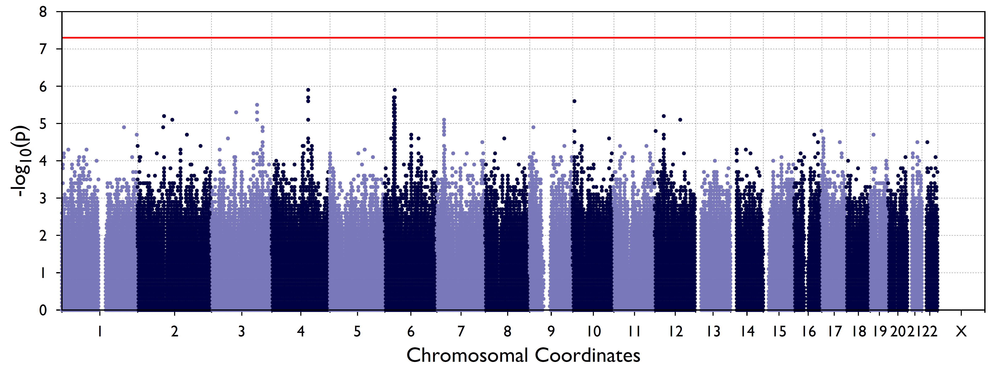
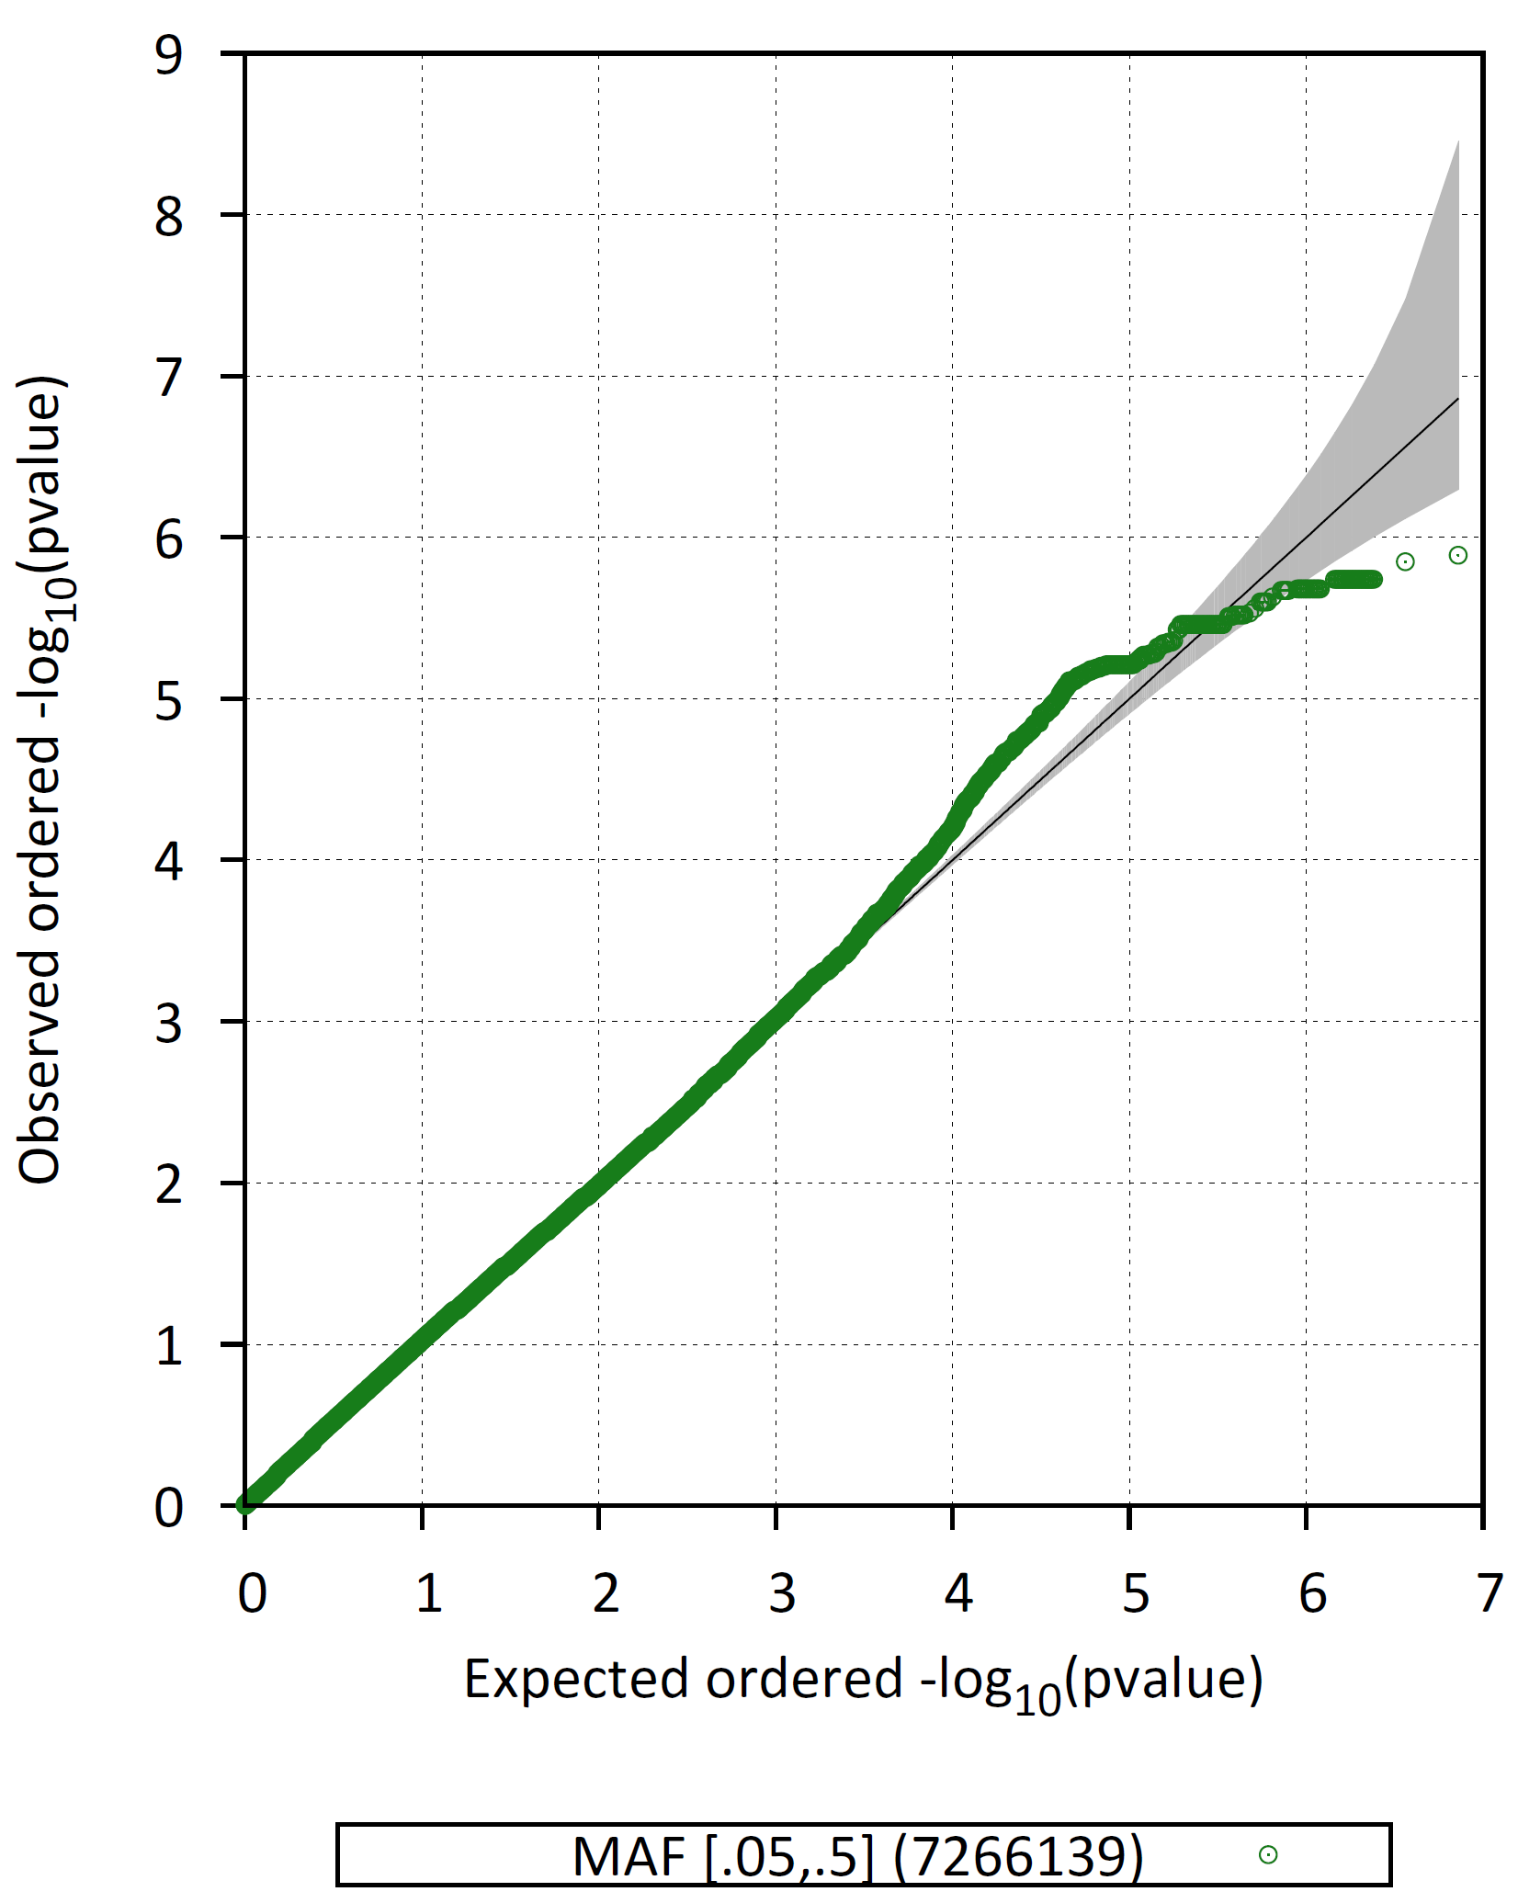
Mixed ancestry: Association [Wald test]
Adjusted for
1 PC
3 PCs
5 PCs
Notes:
QQ plot looks OK after adjusting for 3 PCs. No significant secondary loci

Slide 19
Joint analysis

Slide 20
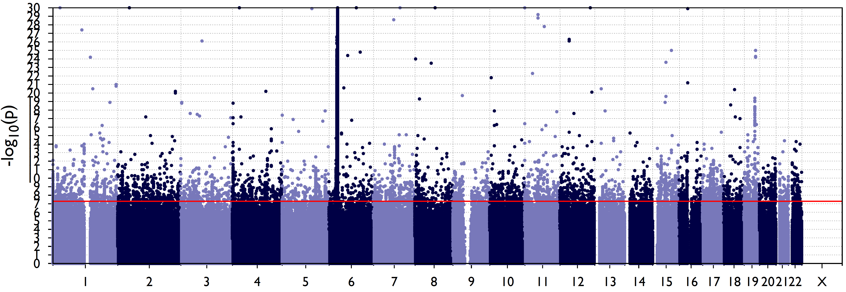
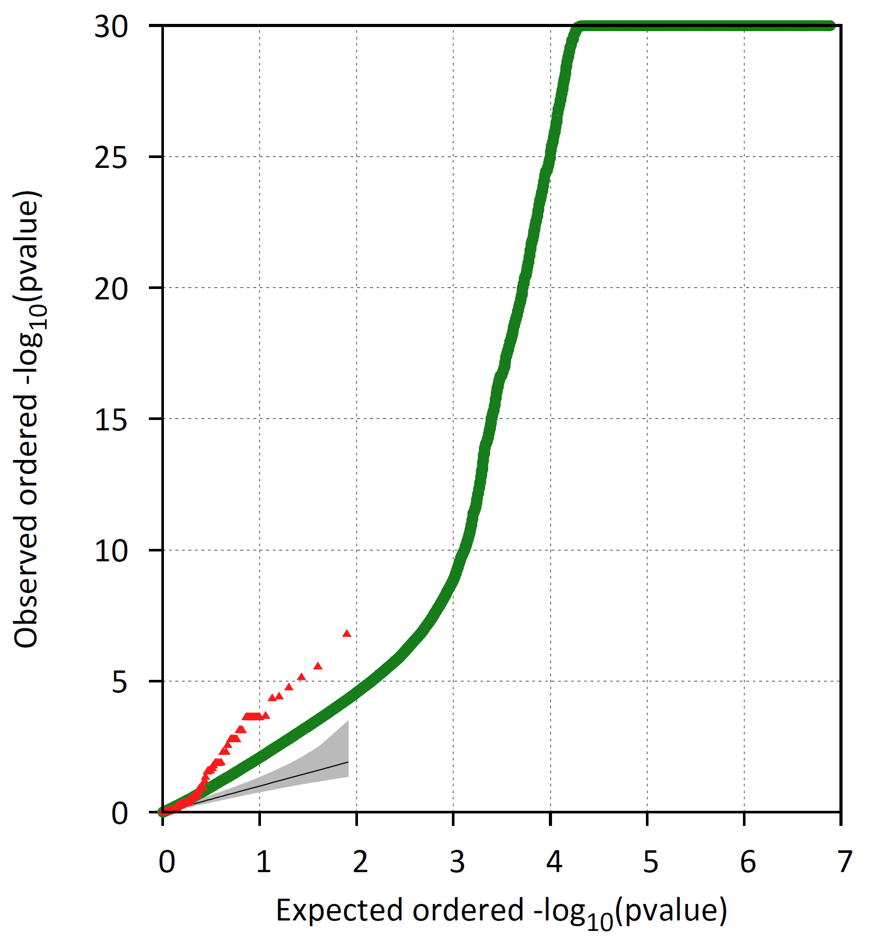
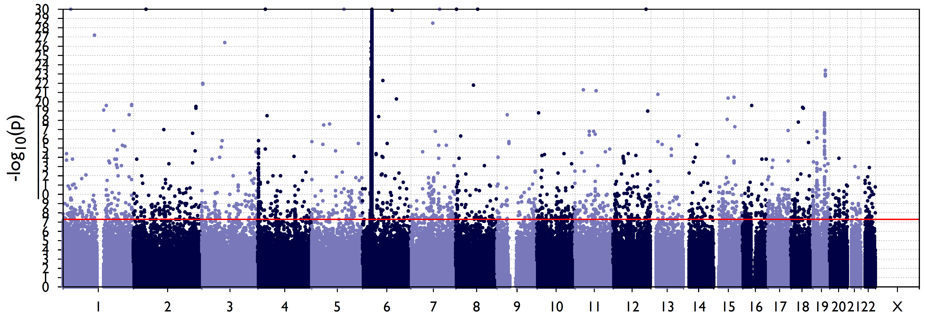
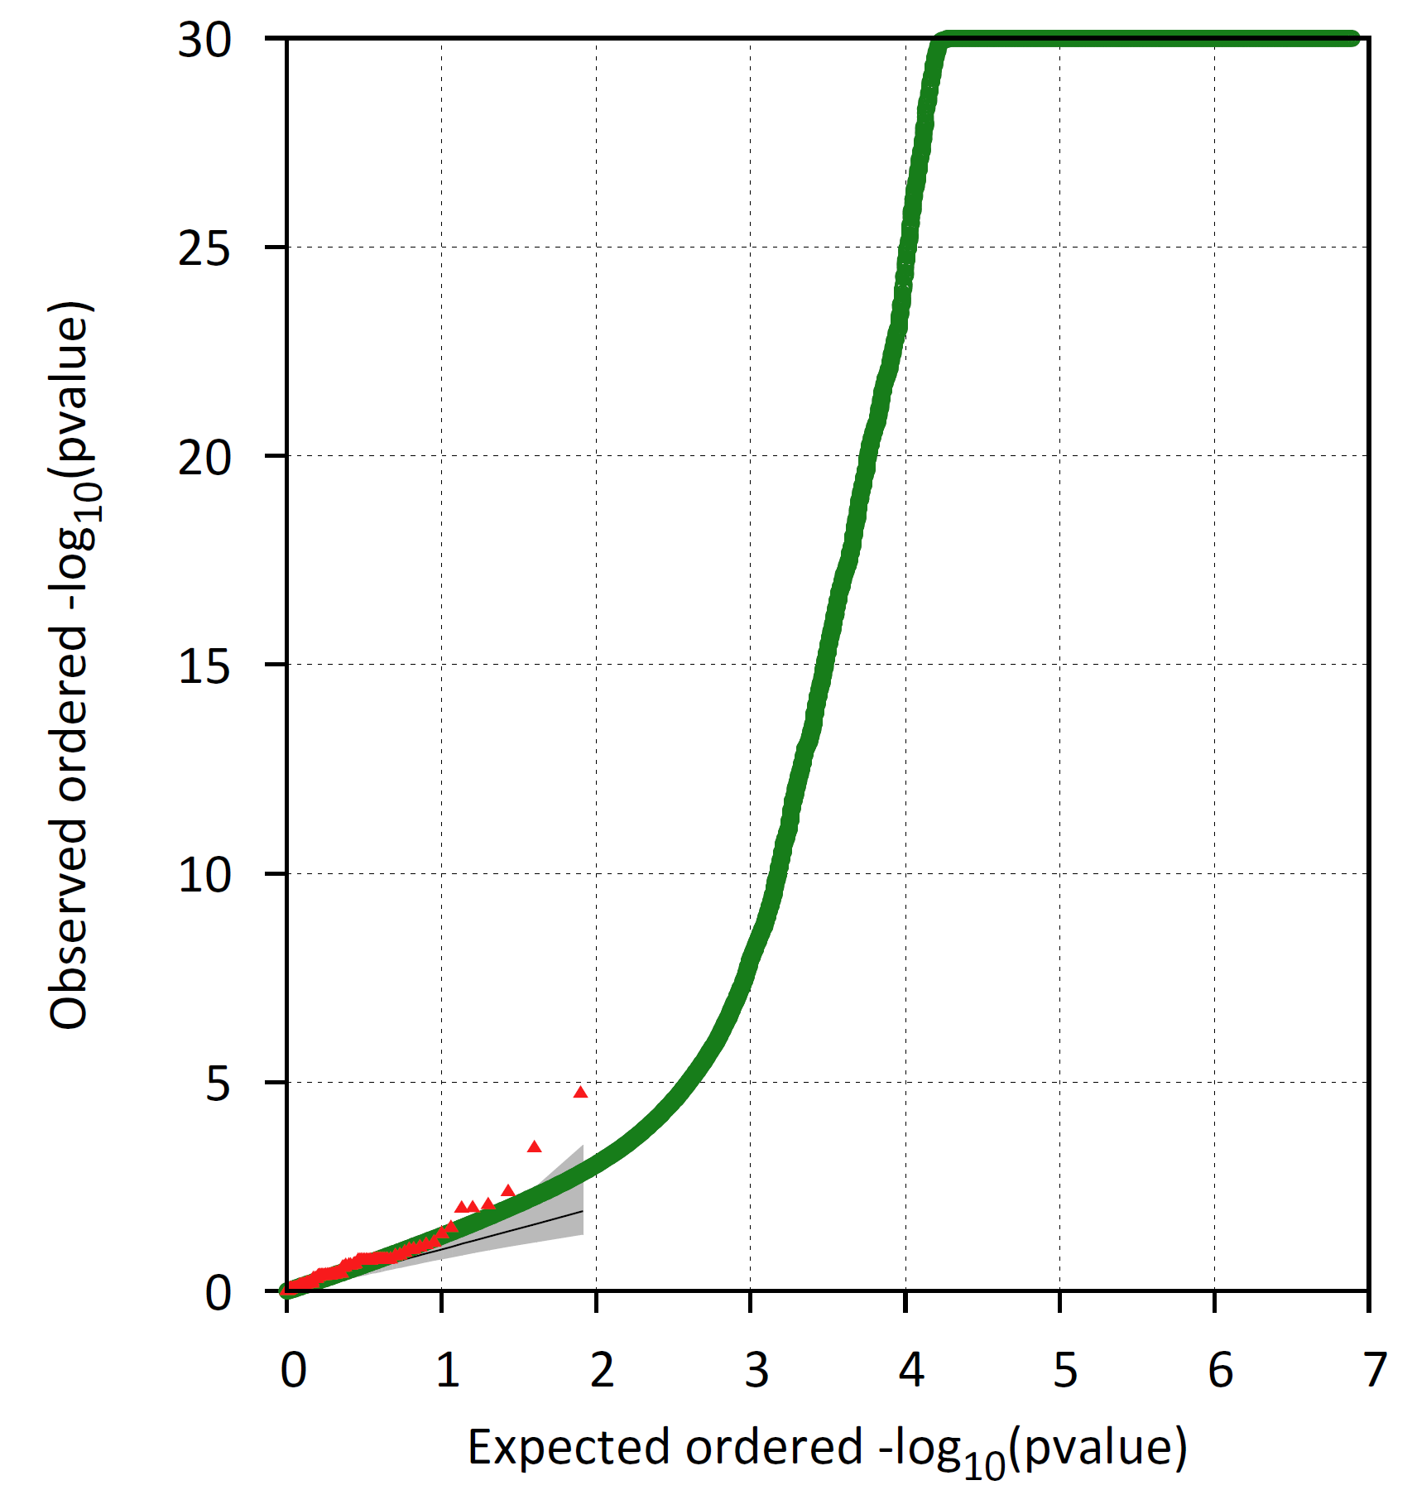
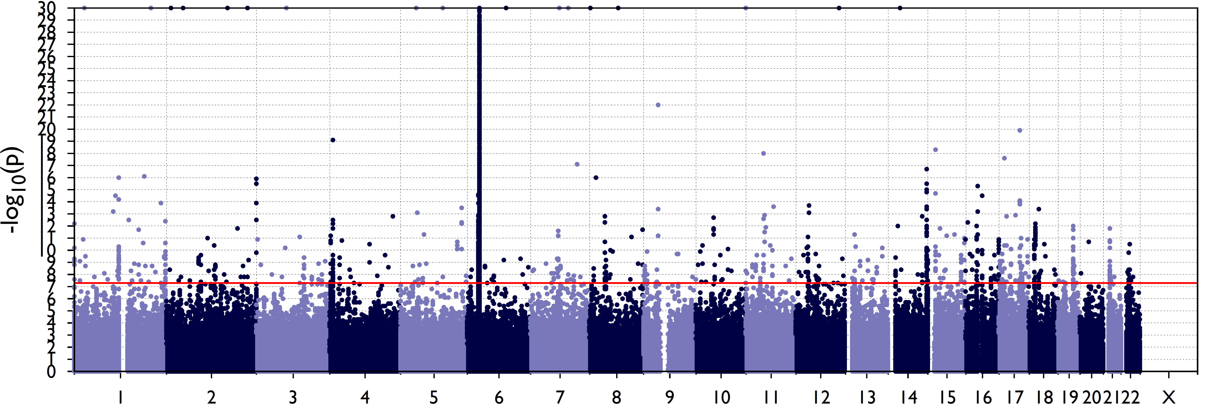
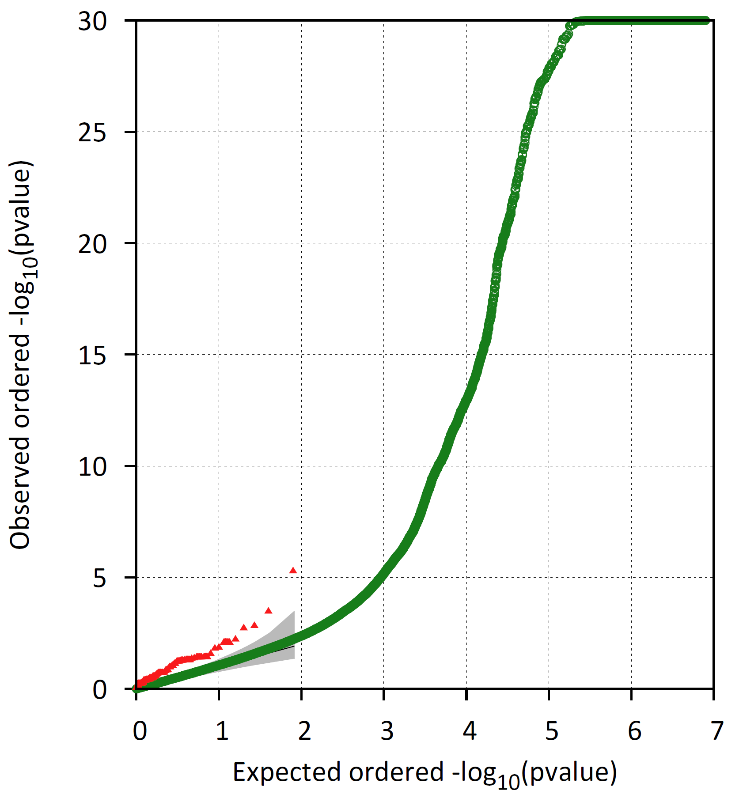
Exploratory joint analysis controlling for PCs
1 PC
3 PCs
5 PCs
Notes:
QQ plot looks OK after 5 PCs but the Manhattan plot shows that there are still scattered markers with small p-values

Slide 21
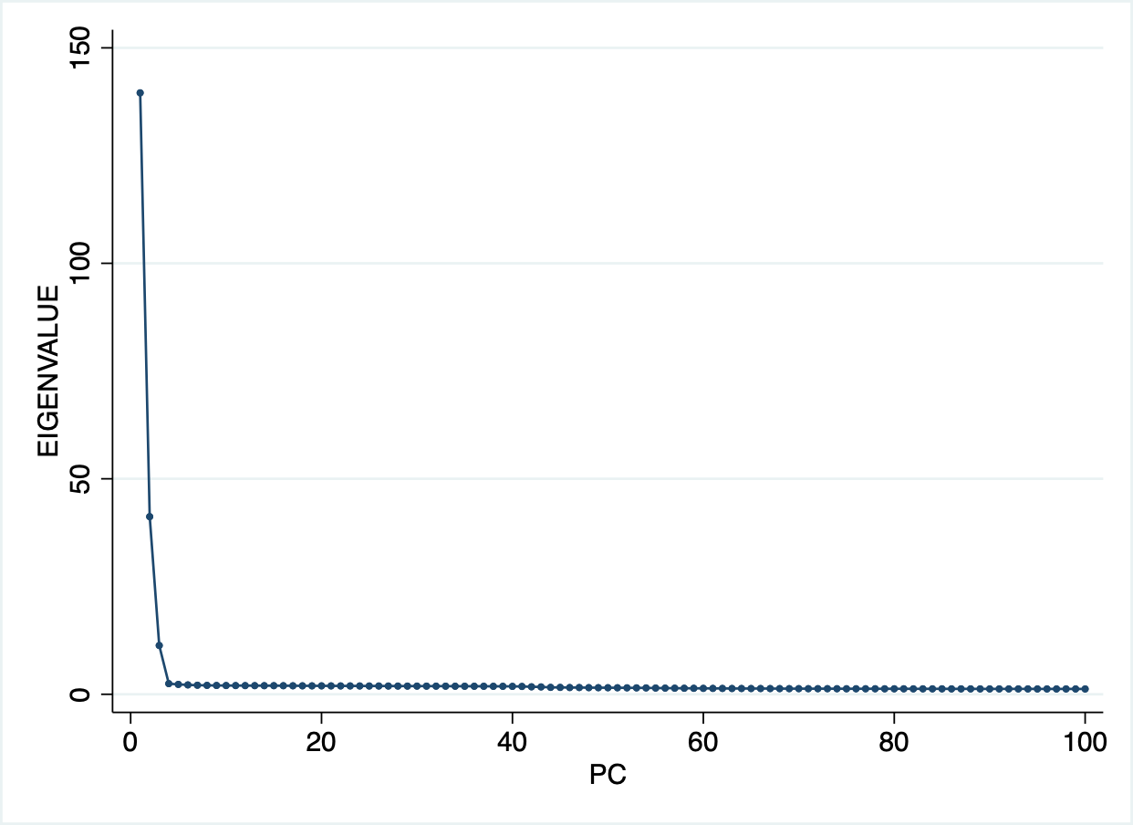
Number of significant PCs
Formal analysis of number of significant PCs
4 [Minimum Average Partial test - Shriner, 2012]
5 [Tracy-Widom test – Tracy & Widom, 1994; Patterson et al, 2006)
Distribution of eigenvalues and scree plot

Slide 22
Exploratory analysis controlling for GRM and 4 PCs
4 PCs only
Wald test
GRM only
emmax
GRM and 4 PCs
emmax
Notes:
Population stratification not controlled.

Slide 23
Analysis using Firth bias-corrected logistic model [adjusting for 4 PCs]
Notes:
Not helpful

Slide 24
Summary points
Successful selection of 1000G controls matched for ancestry
As expected, there is significant population stratification
Per population group analysis shows group specific hits outside chr. 6 locus [SSNS Asian analysis needs checking]
Number of significant PCs to adjust for in association tests 4-5 but first 5 PCs gives better QQ and Manhattan plots than any model including kinship matrix
Joint analysis still not satisfactory even after adjustment for computed kinship matrix and PCs

Slide 25
Next steps
Troubleshooting of SSNS Asian analysis
Explore joint analysis further
Meta-analysis of individual population group summary statistics
Analysis with mixed logistic model [e.g. GMMAT]
Analysis with method that accounts for case-control imbalance (SAIGE)
Annotation of top hits
In silico replication of novel hits

